Slide 1
Creating Objects
On Heap - QObject with parent:
QLabel *label = new QLabel("Some Text", parent);
QLayout::addWidget() and QWidget::setLayout() re-parent children automatically
On Stack - QObject without parent:
QFile, usually local to a function
QApplication (local to main())
Top level QWidgets: QMainWindow
On Stack - "value" types
QString name;
QStringList list;
QColor color;
Do not inherit QObject
Passed by value everywhere
Exception: QString is implicitly shared (COW strategy)
Stack or Heap - QDialog - depending on lifetime

Slide 2
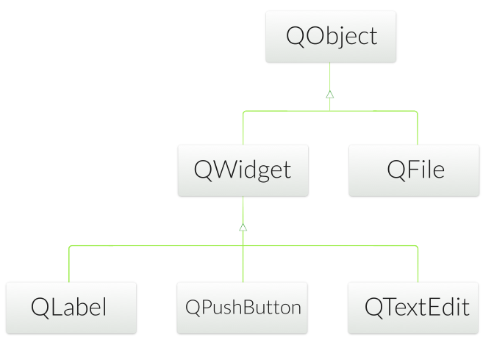
Qt’s Widget Model - QWidget
Derived from QObject
Adds visual representation
Base of user interface objects
Receives events
e.g. mouse, keyboard events
Paints itself on screen
Using styles

Slide 3
Object Tree and QWidget
new QWidget(0)
Widget with no parent = "window"
QWidget’s children
Positioned in parent’s coordinate system
Clipped by parent’s boundaries
QWidget parent
Propagates state changes
hides/shows children when it is hidden/shown itself
enables/disables children when it is enabled/disabled itself
Tristate mechanism
For hide/show and enable/disable, ensures that e.g. an explicitly hidden child is not shown when the parent is shown.

Slide 4
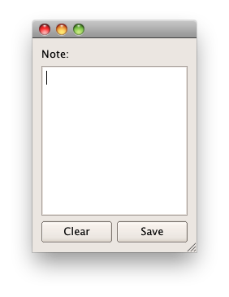
Widgets that Contain Other Widgets
Container Widget
Aggregates other child-widgets
Use layouts for aggregation
In this example: QHBoxLayout and QVBoxLayout
Note: Layouts are not widgets
Layout Process
Add widgets to layout
Layouts may be nested
Set layout on container widget

Slide 5
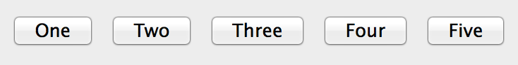
Example Container Widget
void DemoWidget::addButtons(QLayout *layout)
{
layout->addWidget(new QPushButton("One"));
layout->addWidget(new QPushButton("Two"));
layout->addWidget(new QPushButton("Three"));
layout->addWidget(new QPushButton("Four"));
layout->addWidget(new QPushButton("Five"));
}
void DemoWidget::createHBoxLayout()
{
QHBoxLayout *layout = new QHBoxLayout;
addButtons(layout);
setLayout(layout);
}
int main(int argc, char *argv[]) {
QApplication app(argc, argv);
DemoWidget row;
row.createHBoxLayout();
row.show();
return app.exec();
}
Demo: ex-layout

Slide 6
Qt Training – Widget Edition
January 2016
Based on Qt 5.6
N.N.
N.N@company.com

Slide 7
Contents
Widgets | Common Widgets Layout Management Guidelines for Custom Widgets
Painting and Styling | Painting on Widgets Color Handling Painting Operations Style Sheets
Application Creation | Main Windows Settings Resources Translation for Developers Deploying Qt Applications
Dialogs | Dialogs Common Dialogs Qt Designer

Slide 8
Contents
Model/View Framework | Model/View Concept Showing Simple Data Proxy Models Custom Models Delegates Editing item data Data Widget Mapper Drag and Drop Custom Tree Model Data Widget Mapper
GraphicsView | Using GraphicsView Classes Coordinate Systems and Transformations Creating Custom Items Widgets in a Scene Drag and Drop Effects Performance Tuning

Slide 9
Objevtives
To get a good practical experience on
User interface programming using widgets
To be able to start serious UI development or continue efficient widget-based UI development after the training
Any questions at any point – please do not hesitate to ask!

Slide 10


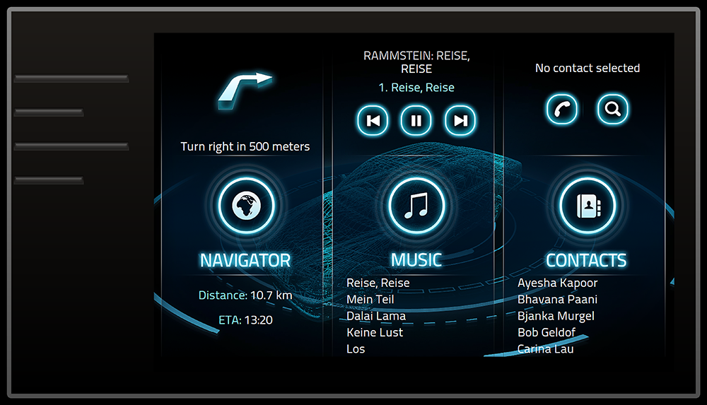
Qt UI Offering – Choose the Best of All Worlds
Qt Quick
C++ on the back, declarative UI design (QML) in the front for beautiful, modern touch-based User Experiences.
Qt Widgets
Customizable C++ UI controls for traditional desktop look-and-feel. Also good for more static embedded UIs for more limited devices / operating systems.
Web / Hybrid
Use HTML5 for dynamic web documents, Qt Quick for native interaction.

Slide 11
Widgets

Slide 12
Contents
Common Widgets
Layout Management
Guidelines for Custom Widgets

Slide 13
Objectives
Common Widgets
Text widgets
Value based widgets
Organizer widgets
Item-based widgets
Layout Management
Geometry management
Advantages of layout managers
Qt's layout managers
Size policies
Custom Widgets
Rules for creating own widgets

Slide 14
Common Widgets

Slide 15
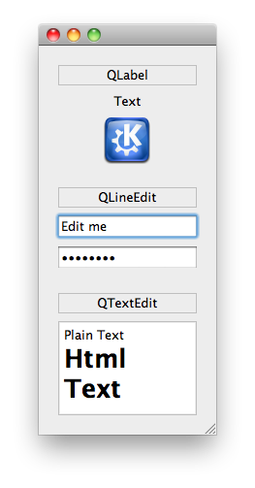
Text Widgets
QLabel
label = new QLabel("Text", parent);
setPixmap( pixmap ) - as content
QLineEdit
line = new QLineEdit(parent);
line->setText("Edit me");
line->setEchoMode(QLineEdit::Password);
connect(line, SIGNAL(textChanged(QString)) ...
connect(line, SIGNAL(editingFinished()) ...
setInputMask( mask )
setValidator( validator )
QTextEdit
edit = new QTextEdit(parent);
edit->setPlainText("Plain Text");
edit->append("<h1>Html Text</h1>");
connect(edit, SIGNAL(textChanged(QString)) ...

Slide 16
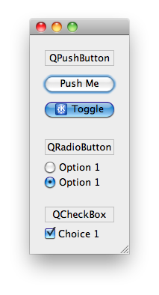
Button Widgets
QAbstractButton
Abstract base class of buttons
QPushButton
button = new QPushButton("Push Me", parent);
button->setIcon(QIcon("images/icon.png"));
connect(button, SIGNAL(clicked()) ...
setCheckable(bool)-togglebutton
QRadioButton
radio = new QRadioButton("Option 1", parent);
QCheckBox
check = new QCheckBox("Choice 1", parent);
QButtonGroup - non-visual button manager
group = new QButtonGroup(parent);
group->addButton(button); // add more buttons
group->setExclusive(true);
connent(group, SIGNAL(buttonClicked(QAbstractButton*))

Slide 17
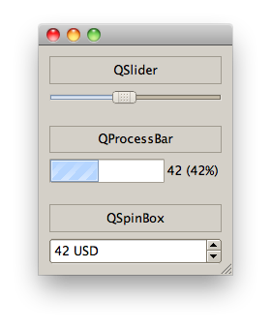
Value Widgets
QSlider
slider = new QSlider(Qt::Horizontal, parent);
slider->setRange(0, 99);
slider->setValue(42);
connect(slider, SIGNAL(valueChanged(int)) ...
QProgressBar
progress = new QProgressBar(parent);
progress->setRange(0, 99);
progress->setValue(42); // format: %v for value; %p for percentage
progress->setFormat("%v (%p%)");
QSpinBox
spin = new QSpinBox(parent);
spin->setRange(0, 99);
spin->setValue(42);
spin->setSuffix(" USD");
connect(spin, SIGNAL(valueChanged(int))

Slide 18
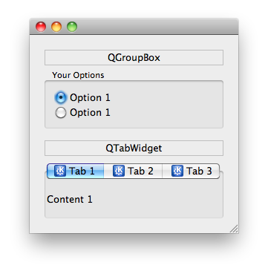
Organizer Widgets
QGroupBox
box = new QGroupBox("Your Options", parent);
// ... set layout and add widgets
setCheckable( bool ) - checkbox in title
QTabWidget
tab = new QTabWidget(parent);
tab->addWidget(widget, icon, "Tab 1");
connect(tab, SIGNAL(currentChanged(int)) ...
setCurrentWidget( widget )
Displays page associated by widget
setTabPosition( position )
Defines where tabs are drawn
setTabsClosable( bool )
Adds close buttons

Slide 19
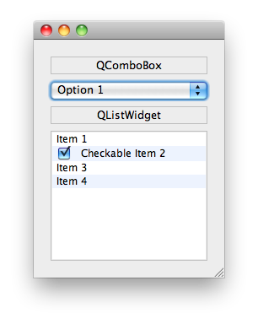
Item Widgets
QComboBox
combo = new QComboBox(parent);
combo->addItem("Option 1", data);
connect(combo, SIGNAL(activated(int)) ...
QVariant data = combo->itemData(index);
setCurrentIndex( index )
QListWidget
list = new QListWidget(parent);
list->addItem("Item 1");
// ownership of items with list
tem = new QListWidgetItem("Item 2", list); item->setCheckState(Qt::Checked);
connect(list, SIGNAL(itemActivated(QListWidgetItem*)) ...
QListWidgetItem::setData(Qt::UserRole, data)
Other Item Widgets: QTableWidget, QTreeWidget

Slide 20
Other Widgets
QToolBox
Column of tabbed widget items
QDateEdit, QTimeEdit, QDateTimeEdit
Widget for editing date and times
QCalendarWidget
Monthly calendar widget
QToolButton
Quick-access button to commands
QSplitter
Implements a splitter widget
QStackedWidget
Stack of widgets
Only one widget visible at a time

Slide 21
Layout Management

Slide 22
Doing it Yourself
Place and resize widgets
move()
resize()
setGeometry()
Example:
QWidget *parent = new QWidget(...);
parent->resize(400,400);
QCheckBox *cb = new QCheckBox(parent);
cb->move(10, 10);

Slide 23
Making Qt Do the Work
Definition
Layout: Specifying the relations of elements to each other instead of the absolute positions and sizes.
Advantages:
Works with different languages.
Works with different dialog sizes.
Works with different font sizes.
Better to maintain.
Disadvantage
Need to think about your layout first.
Thinking about layout is not really a disadvantage!

Slide 24
Managed Widgets and Sizes
On managed widgets never call
setGeometry(), resize(), or move()
Preferred
Override
sizeHint()
minimumSizeHint()
Or call
setFixedSize()
setMinimumSize()
setMaximumSize()

Slide 25
Layout Management Classes
QHBoxLayout
Lines up widgets horizontally
QVBoxLayout
Lines up widgets vertically
QGridLayout
Arranges the widgets in a grid
QFormLayout
Lines up a (label, widget) pairs in two columns.
QStackedLayout
Arranges widgets in a stack
Only top most is visible

Slide 26
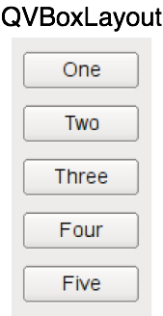
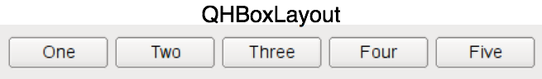
QHBoxLayout and QVBoxLayout
Lines up widgets horizontally or vertically
Divides space into boxes
Each managed widgets fills in one box
QWidget* window = new QWidget;
QPushButton* one = new QPushButton("One");
…
QHBoxLayout* layout = new QHBoxLayout;
layout->addWidget(one);
…
window->setLayout(layout);

Slide 27
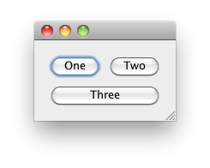
Widgets in a Grid - QGridLayout
QWidget* window= new QWidgetn;
QPushButton* one = new QPushButton("One");
QGridLayout* layout = new QGridLayout;
layout->addWidget(one, 0, 0); // row:0, col:0
layout->addWidget(two, 0, 1); // row:0, col:1
// row:1, col:0, rowSpan:1, colSpan:2
layout->addWidget(three, 1, 0, 1, 2);
window->setLayout(layout)
Additional
setColumnMinimumWidth() (minimum width of column)
setRowMinimumHeight() (minimum height of row)
No need to specify rows and columns before adding children.
Demo: ex-layout

Slide 28
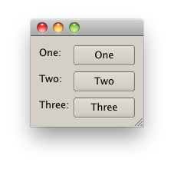
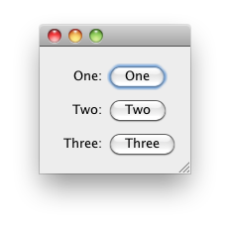
QFormLayout
A two-column layout
Column 1 a label (as annotation)
Column 2 a widget (as field)
Respects style guide of individual platforms.
QWidget* window = new QWidget();
QPushButton* one = new QPushButton("One"); …
QFormLayout* layout = new QFormLayout();
layout->addRow("One", one);
..
window->setLayout(layout)
Form layout with clean looks and mac style
Demo: ex-layout

Slide 29
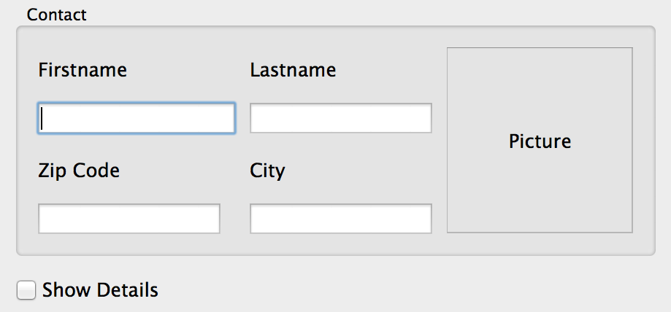
Lab – Contact Form
Specified by graphic designer
Your task: implement it
Focus on correct layout
Details disabled by default
'ShowDetails’ enables details
Optional:
Click on Picture
Lets user choose image
See lab description
Validate Zip-Code as integers
Lab: lab-contactform

Slide 30
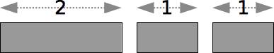
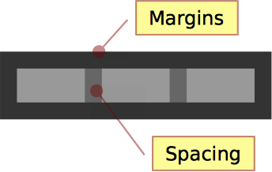
Some Layout Terms
Stretch
Relative size factor
QBoxLayout::addWidget(widget, stretch)
QBoxLayout::addStretch(stretch)
QGridLayout::setRowStretch(row, stretch)
QGridLayout::setColumnStretch(col, stretch)
Contents Margins
Space reserved around the managed widgets.
QLayout::setContentsMargins(l,t,r,b)
Spacing
Space reserved between widgets
QBoxLayout::addSpacing(size)

Slide 31
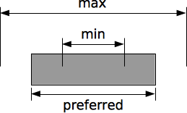
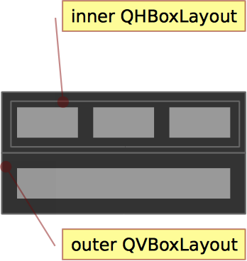
More Layout Terms
Strut
Limits perpendicular box dimension
e.g. height for QHBoxLayout
Only for box layouts
Min, max and fixed sizes
QWidget::setMinimumSize( QSize )
QWidget::setMaximumSize( QSize )
QWidget::setFixedSize( QSize )
Individual width and height constraints also available
Nested Layouts
Allows flexible layouts
QLayout::addLayout(...)
Demo: ex-customlayout

Slide 32
Widgets Size Policies
QSizePolicy describes interest of widget in resizing
QSizePolicy policy = widget->sizePolicy();
policy.setHorizontalPolicy(QSizePolicy::Fixed);
widget->setSizePolicy(policy);
One policy per direction (horizontal and vertical)
Button-like widgets set size policy to the following:
May stretch horizontally
Are fixed vertically
Similar to QLineEdit, QProgressBar, ...
Widgets which provide scroll bars (e.g. QTextEdit)
Can use additional space
Work with less than sizeHint()
sizeHint(): recommended size for widget

Slide 33
Available Size Policies
Policy | sizeHint() | Widget
Fixed | authoritative | cannot grow or shrink
Minimum | minimal, sufficient | can expand, no advantage of being larger
Maximum | is maximum | can shrink
Preferred | is best | can shrink, no advantage of being larger
Minimum Expanding | is minimum | can use extra space
Expanding | sensible size | can grow and shrink

Slide 34
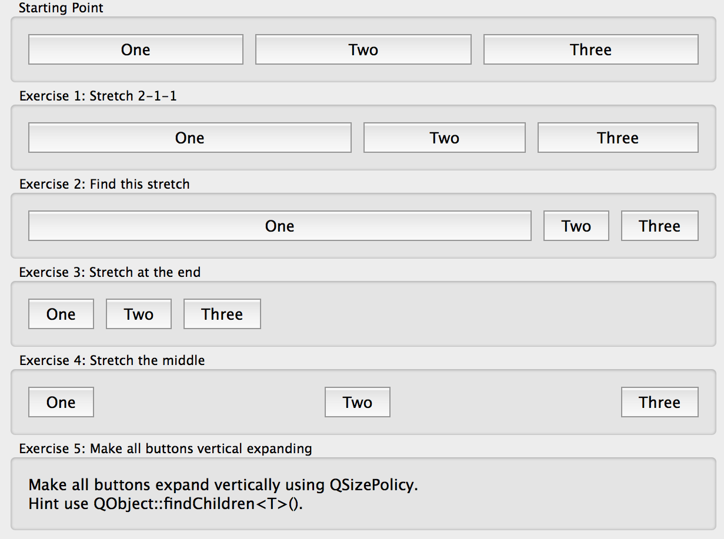
Lab – Layout of buttons
Develop the following layouts
Adjust the layouts as shown below.
Optionally:
Make buttons resize vertically when making the window higher.
Lab: lab-layoutbuttons

Slide 35
Questions And Answers
How do you change the minimum size of a widget
Name the available layout managers.
How do you specify stretch? When are you allowed to call resize and move on a widget?

Slide 36
Guidelines for Custom Widgets

Slide 37
Guidelines: Creating a Custom Widget
It's as easy as deriving from QWidget
class CustomWidget : public QWidget
{
public:
explicit CustomWidget(QWidget* parent=0);
}
If you need custom Signal Slots
Add Q_OBJECT
Use layouts to arrange widgets inside, or paint the widget yourself.

Slide 38
Guidelines: Base Class and Event Handlers
Do not reinvent the wheel
Decide on a base class
Often QWdget or QFrame
Overload needed event handlers
Often:
QWidget::mousePressEvent(),
QWidget::mouseReleaseEvent()
If widget accepts keyboard input
QWidget::keyPressEvent()
If widget changes appearance on focus
QWidget::focusInEvent(),
QWidget::focusOutEvent()

Slide 39
Guidelines: Drawing a Widget
Decide on composite or draw approach
If composite: Use layouts to arrange other widgets
If draw: implement paint event
Re-implement QWidget::paintEvent() for drawing
To draw widget's visual appearance
Drawing often depends on internal states
Decide which signals to emit
Usually from within event handlers
Especially mousePressEvent() or mouseDoubleClickEvent()
Decide carefully on types of signal parameters
General types increase reusability
Candidates are bool, int and const QString&

Slide 40
Guidelines: Internal States and Subclassing
Decide on publishing internal states
Which internal states should be made publically accessible?
Implement accessor methods
Decide which setter methods should be slots
Candidates are methods with integral or common parameters
Decide on allowing sub-classing
If yes
Decide which methods to make protected instead of private
Which methods to make virtual

Slide 41
Guidelines: Widget Constructor
Decide on parameters at construction time
Enrich the constructor as necessary
Or implement more than one constructor
If a parameter is needed for widget to work correctly
User should be forced to pass it in the constructor
Keep the Qt convention with:
explicit Constructor(..., QWidget *parent = 0)

Slide 42
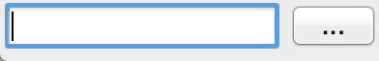
Lab – File Chooser
Create a reusable file chooser component
2 Modes
Choose File
Choose Directory
Think about the Custom Widget Guidelines!
Create a reusable API for a FileChooser?
After lab discuss your API
Lab: lab-filechooser

Slide 43
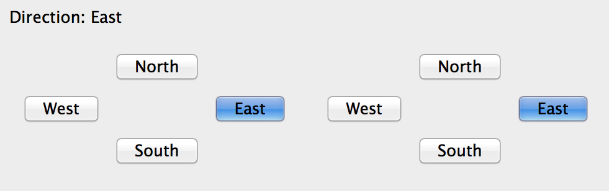
Lab – Compass Widget
Implement a “compass widget” and let user...
Select a direction
north, west, south, east
And optionally none
Provide API to…
Change direction programmatically
Get informed when direction changes
Optional
Add direction None
Select direction with the keyboard
Lab: lab-compasswidget

Slide 44
Painting and Styling

Slide 45
Contents
Painting on Widgets
Color Handling
Painting Operations
Style Sheets

Slide 46
Objectives
Painting
You paint with a painter on a paint device during a paint event
Qt widgets know how to paint themselves
Often widgets look like we want
Painting allows device independent 2D visualization
Allows to draw pie charts, line charts and many more
Style Sheets
Fine grained control over the look and feel
Easily applied using style sheets in CSS format

Slide 47
Objectives
Covers techniques for general 2D graphics and styling applications.
Painting
Painting infrastructure
Painting on widget
Color Handling
Define and use colors
Pens, Brushes, Palettes
Shapes
Drawing shapes
Transformation
2D transformations of a coordinate system
Style Sheets
How to make small customizations
How to apply a theme to a widget or application

Slide 48
Painting on Widgets

Slide 49
Low-level Painting with QPainter
Paints on paint devices (QPaintDevice)
QPaintDevice implemented by
On-Screen: QWidget
Off-Screen: QImage, QPixmap
And others...
Provides drawing functions
Lines, shapes, text or pixmaps
Controls
Rendering quality
Clipping
Composition modes

Slide 50
Painting on Widgets
Override paintEvent(QPaintEvent*)
void CustomWidget::paintEvent(QPaintEvent *) {
QPainter painter(this);
painter.drawRect(0,0,100,200); // x,y,w,h
}
Schedule painting
update(): schedules paint event
repaint(): repaints directly
Qt handles double-buffering
To enable filling background:
QWidget::setAutoFillBackground(true)

Slide 51
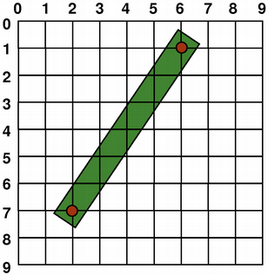
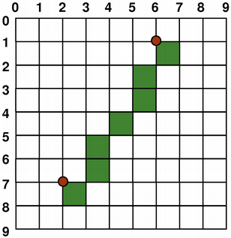
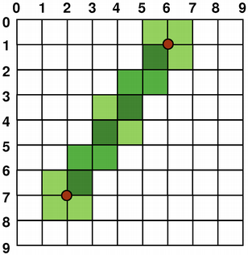
Coordinate System - Surface to Render
Controlled by QPainter
Origin: Top-Left • Rendering
Logical-mathematical
Aliased-right and below
Anti-aliased-smoothing
Rendering quality switch
QPainter::setRenderHint()

Slide 52
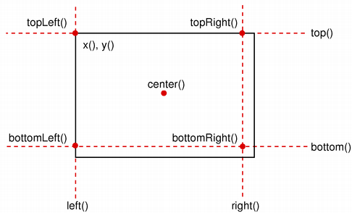
Geometry Helper Classes
QSize(w,h)
scale, transpose
QPoint(x,y)
QLine(point1, point2)
translate, dx, dy
QRect(point, size)
adjust, move
translate, scale, center
QSize size(100,100);
QPoint point(0,0);
QRect rect(point, size);
rect.adjust(10,10,-10,-10);
QPoint center = rect.center();

Slide 53
Color Handling

Slide 54
Creating Color Values
Using different color models:
QColor(255,0,0) // RGB
QColor::fromHsv(h,s,v) // HSV
QColor::fromCmyk(c,m,y,k) // CMYK
Defining colors:
QColor(255,0,0); // red in RGB
QColor(255,0,0, 63); // red 25% opaque (75% transparent)
QColor("#FF0000"); // red in web-notation
QColor("red"); // by svg-name
Qt::red; // predefined Qt global colors
Many powerful helpers for manipulating colors
QColor("black").lighter(150); // a shade of gray
QColor always refers to device color space

Slide 55
Drawing Lines and Outlines with QPen
A pen (QPen) consists of:
A color or brush
A width
A style (e.g. NoPen or SolidLine)
A cap style (i.e. line endings)
A join style (connection of lines)
Activate with QPainter::setPen()
QPainter painter(this);
QPen pen = painter.pen();
pen.setBrush(Qt::red);
pen.setWidth(3);
painter.setPen(pen);
// draw a rectangle with 3 pixel width red outline
painter.drawRect(0,0,100,100);

Slide 56
The Outline
Rule: The outline equals the size plus half the pen width on each side.
For a pen of width 1:
QPen pen(Qt::red, 1); // width = 1
float hpw = pen.widthF()/2; // half-pen width
QRectF rect(x, y, width, height);
QRectF outline = rect.adjusted(-hpw, -hpw, hpw, hpw);
Due to integer rounding on a non-antialiased grid, the outline is shifted by 0.5 pixel towards the bottom right.
Demo: ex-rectoutline

Slide 57

Filling Shapes with QBrush
QBrush defines fill pattern of shapes
Brush configuration
setColor(color)
setStyle(Qt::BrushStyle)
NoBrush, SolidPattern,…
QBrush(gradient) // QGradient's
setTexture(pixmap)
Brush with solid red fill
painter.setPen(Qt::red);
painter.setBrush(QBrush(Qt::yellow, Qt::SolidPattern));
painter.drawRect(rect);

Slide 58
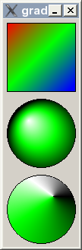
Drawing Gradient Fills
Gradients used with QBrush
Gradient types
QLinearGradient
QConicalGradient
QRadialGradient
Gradient from P1(0,0) to P2(100,100)
QLinearGradient gradient(0, 0, 100, 100);
// position, color: position from 0..1
gradient.setColorAt(0, Qt::red);
gradient.setColorAt(0.5, Qt::green);
gradient.setColorAt(1, Qt::blue);
painter.setBrush(gradient);
// draws rectangle, filled with brush
painter.drawRect(0, 0, 100, 100 );
Demo: ex-gradients

Slide 59
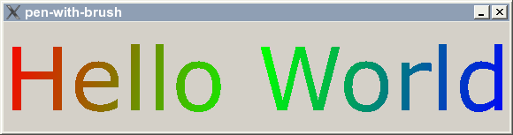
Brush on QPen
Possible to set a brush on a pen
Strokes generated will be filled with the brush
Demo: ex-penwithbrush

Slide 60
Color Themes and Palettes
To support widgets color theming
setColor(blue) not recommended
Colors need to be managed
QPalette manages colors
Consist of color groups
enum QPalette::ColorGroup
Resemble widget states
QPalette::Active
Used for window with keyboard focus
QPalette::Inactive
Used for other windows
QPalette::Disabled
Used for disabled widgets

Slide 61
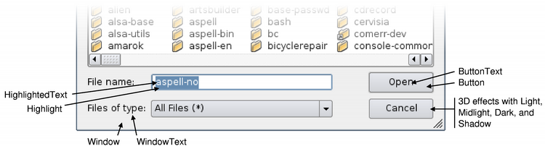
Color Groups and Roles
Color group consists of color roles
enum QPalette::ColorRole
Defines symbolic color roles used in UI
QPalette pal = widget->palette();
QColor color(Qt::red);
pal.setColor(QPalette::Active, QPalette::Window, color);
// for all group
pal.setBrush(QPalette::Window, QBrush(Qt::red));
widget->setPalette(pal);
QApplication::setPalette()
Sets application wide default palette

Slide 62
Painting Operations

Slide 63
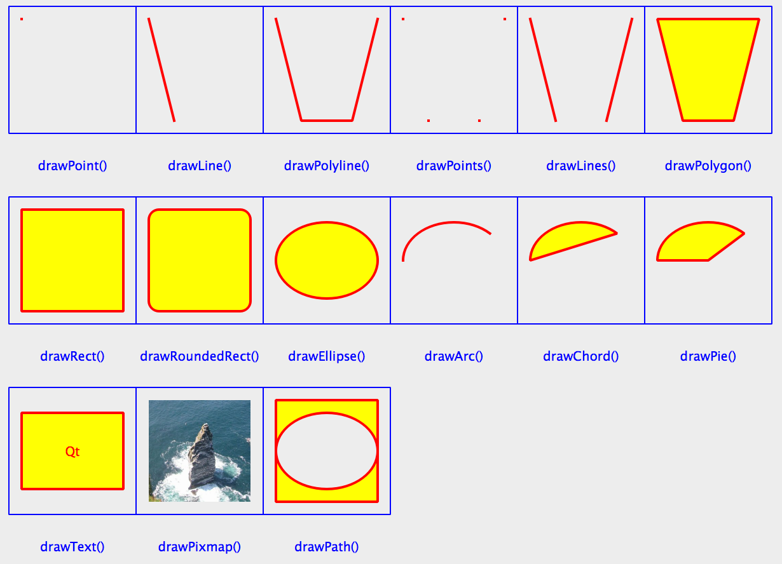
Drawing Figures
Painter configuration
Pen width: 2
Pen color: red
Font size:10
Brush color: yellow
Brush style: solid
Demo: ex-figures

Slide 64
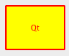
Drawing Text
QPainter::drawText(rect, flags, text)
QPainter painter(this);
painter.drawText(rect, Qt::AlignCenter, tr("Qt"));
painter.drawRect(rect);
QFontMetrics
Calculate size of strings
QFont font("times", 24);
QFontMetrics fm(font);
nt pixelsWide = fm.width("Width of this text?");
int pixelsHeight = fm.height();

Slide 65
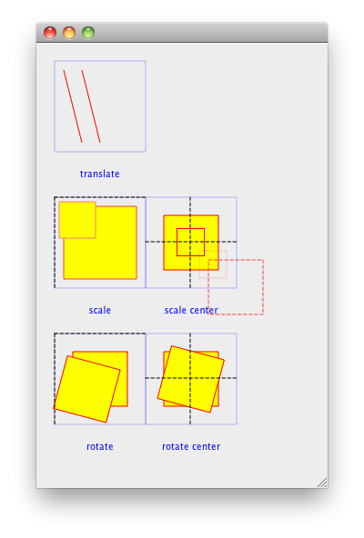
Transformation
Manipulating the coordinate system
translate(x,y)
scale(sx,sy)
rotate(a)
shear(sh,sv)
reset()
Demo: ex-transform

Slide 66
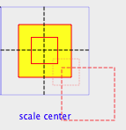
Transform and Center
scale(sx,sy)
Scales around QPoint(0,0)
Same applies to all transform operations
Scale around center?
painter.drawRect(r);
painter.translate(r.center());
painter.scale(sx,sy);
painter.translate(-r.center());
// draw center-scaled rect
painter.drawRect(r);
Demo: ex-transform

Slide 67

Painter Path - QPainterPath
Container for painting operations
Enables reuse of shapes
QPainterPath path;
path.addRect(20, 20, 60, 60);
path.moveTo(0, 0);
path.cubicTo(99, 0, 50, 50, 99, 99);
path.cubicTo(0, 99, 50, 50, 0, 0);
painter.drawPath(path);
Path information
controlPointRect() – rect containing all points
contains() – test if given shape is inside path
intersects() – test given shape intersects path

Slide 68
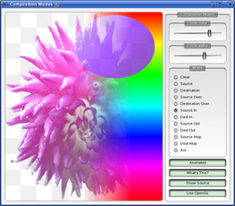
Other Painter Concepts
Clipping
Clip drawing operation to shape
Composition modes:
Rules for digital image compositing
Combining pixels from source to destination
Rubber Bands – QRubberBand
Rectangle or line that indicate selection or boundary

Slide 69
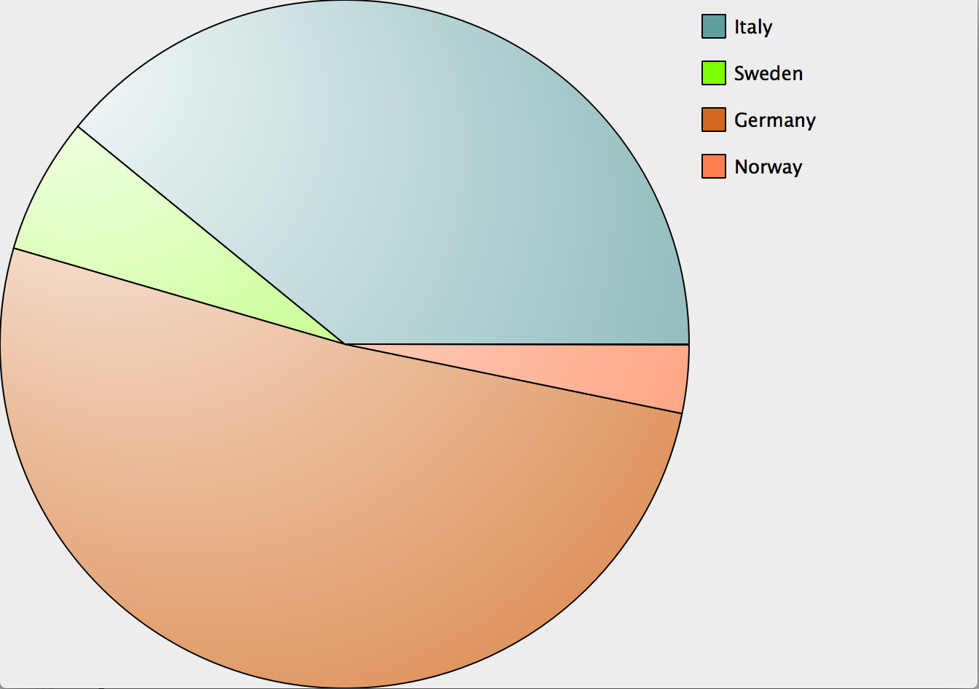
Lab – Pie Chart Widget
Task to implement a pie chart
Draw pies with painters based on data.
Data Example: Population of 4 countries
Sweden
Germany
Norway
Italy
Guess the population in millions of citizens ;-)
Legend is optional
See lab description for details
Lab: lab-piechart

Slide 70
Style Sheets

Slide 71
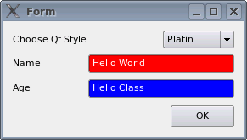
Qt Style Sheets
Mechanism to customize appearance of widgets
Additional to subclassing QStyle
Inspired by HTML CSS
Textual specifications of styles
Applying Style Sheets
QApplication::setStyleSheet(sheet)
On whole application
QWidget::setStyleSheet(sheet)
On a specific widget (incl. child widgets)
Demo: ex-simpleqss

Slide 72
CSS Rules
selector { property : value; property : value }
Selector: specifies the widgets
Property/value pairs: specify properties to change.
QPushButton { color: red; background-color: white }
Examples of stylable elements
Colors, fonts, pen style, alignment.
Background images.
Position and size of sub controls.
Border and padding of the widget itself.

Slide 73
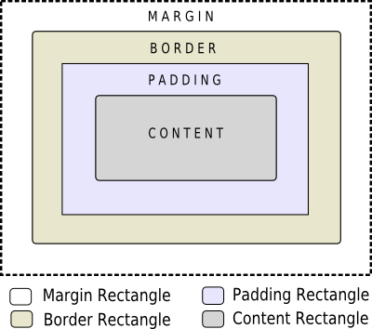

The Box Model
Every widget treated as box
Four concentric rectangles
Margin, Border, Padding, Content
Customizing QPushButton
QPushButton {
border-width: 2px;
border-radius: 10px;
padding: 6px;
// ...
}
By default, margin, border-width, and padding are 0

Slide 74
Selector Types
*{ } // Universal selector
All widgets
QPushButton { } // Type Selector
All instances of class
.QPushButton { } // Class Selector
All instances of class, but not subclasses
QPushButton#objectName // ID Selector
All Instances of class with objectName
QDialog QPushButton { } // Descendant Selector
All instances of QPushButton which are children of QDialog
QDialog > QPushButton { } // Direct Child Selector
All instances of QPushButton which are direct children of QDialog
QPushButton[enabled="true"] // Property Selector
All instances of class which match property

Slide 75
Selector Details
Property Selector
If property changes it is required to re-set style sheet
Combining Selectors
QLineEdit, QComboBox, QPushButton { color: red }
Pseudo-States
Restrict selector based on widget’s state
Example: QPushButton:hover {color:red}
Selecting Subcontrols
Access subcontrols of complex widgets as QComboBox, QSpinBox, ...
QComboBox::drop-down { image: url(dropdown.png) }
Subcontrols positioned relative to other elements
Change using subcontrol-origin and subcontrol-position
Demo: ex-qssselector

Slide 76
Conflict Resolution - Cascading
Effective style sheet obtained by merging
Widgets’s ancestor (parent, grandparent, etc.)
Application stylesheet
On conflict: widget own style sheet preferred
qApp->setStyleSheet("QPushButton { color: white }");
button->setStyleSheet("* { color: blue }");
Style on button forces button to have blue text
In spite of more specific application rule
Demo: ex-qsscascading

Slide 77
Conflict Resolution - Selector Specifity
Conflict: When rules on same level specify same property
Specificity of selectors apply
QPushButton:hover { color: white }
QPushButton { color: red }
Selectors with pseudo-states are more specific
Calculating selector’s specificity
a Count number of ID attributes in selector
b Count number of property specifications
c Count number of class names
Concatenate numbers a-b-c. Highest score wins
If rules scores equal, use last declared rule
QPushButton {} /* a=0 b=0 c=1 -> specificity = 1 */
QPushButton#ok {} /* a=1 b=0 c=1 -> specificity = 101 */
Demo: painting/ex-qssconflict
Demo: ex-qssconflict

Slide 78
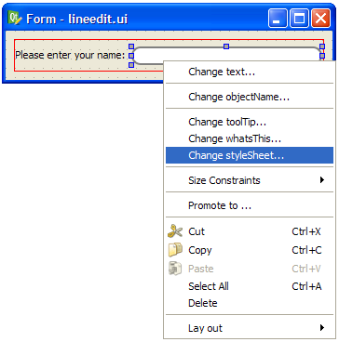
Qt Designer Integration
Excellent tool to preview style sheets
Right-click on any widget
Select Change styleSheet..
Includes syntax highlighter and validator

Slide 79
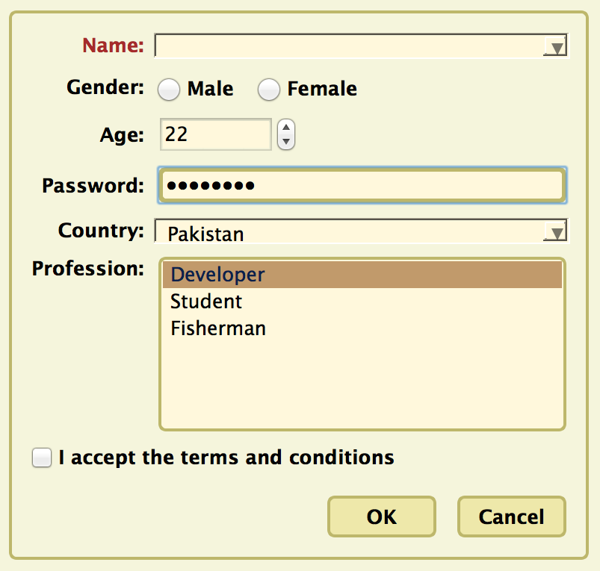
Lab – Project Task
Tasks (in QtCreator Welcome mode, look for ‘Style Sheet Example’)
Investigate style sheet
Modify style sheet
Remove style sheet
and implement your own
Example does not save changes
Use designer for this.
Edit style sheet using
File -> Edit StyleSheet

Slide 80
Application Creation

Slide 81
Contents
Main Windows
Settings
Resources
Translation for Developers
Deploying Qt Applications

Slide 82
Objectives
We will create an application to show fundamental concepts
Main Window: How a typical main window is structured
Settings: Store/Restore application settings
Resources: Adding icons and other files to your application
Translation: Short overview of internationalization
Deployment: Distributing your application

Slide 83
Main Windows

Slide 84
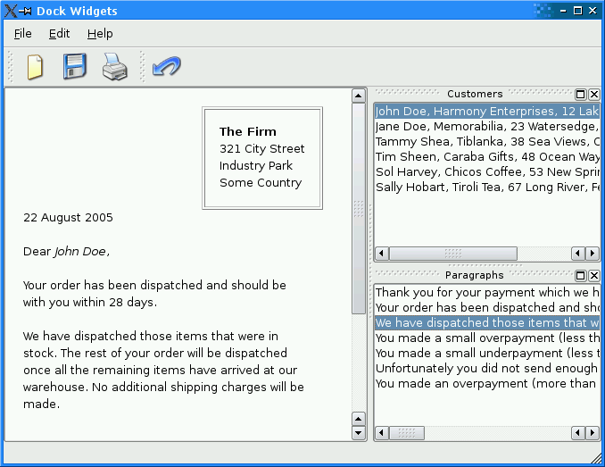
Typical Application Ingredients
Main window with
Menu bar
Tool bar, Status bar
Central widget
Often a dock window
Settings (saving state)
Resources (e.g icons)
Translation
Load/Save documents
Not a complete list

Slide 85
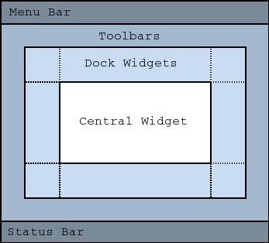
Main Window
QMainWindow: main application window
Has own layout
Central Widget
QMenuBar
QToolBar
QDockWidget
QStatusBar
Central Widget
QMainWindow::setCentralWidget( widget )
Just any widget object
Demo: ex-mainwindow

Slide 86
Creating Actions - QAction
Action is an abstract user interface command
Emits signal triggered on execution
Connected slot performs action
Added to menus, toolbar, key shortcuts
Each performs same way
Regardless of user interface used
void MainWindow::setupActions() {
QAction* action = new QAction(tr("Open ..."), this);
action->setIcon(QIcon(":/images/open.png"));
action->setShortcut(QKeySequence::Open);
action->setStatusTip(tr("Open file"));
connect(action, SIGNAL(triggered()), this, SLOT(onOpen()));
menu->addAction(action);
toolbar->addAction(action);

Slide 87
QAction Capabilities
setEnabled(bool)
Enables disables actions
In menu and toolbars, etc...
setCheckable(bool)
Switches checkable state (on/off)
setChecked(bool) toggles checked state
setData(QVariant)
Stores data with the action

Slide 88

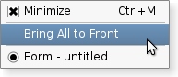
Create Menu Bar
QMenuBar: a horizontal menu bar
QMenu: represents a menu
Indicates action state
QAction: menu items added to QMenu
void MainWindow::setupMenuBar() {
QMenuBar* bar = menuBar();
QMenu* menu = bar->addMenu(tr("&File"));
menu->addAction(action);
menu->addSeparator();
QMenu* subMenu = menu->addMenu(tr("Sub Menu"));
…

Slide 89
Creating Toolbars - QToolBar
Movable panel…
Contains set of controls
Can be horizontal or vertical
QMainWindow::addToolbar( toolbar )
Adds toolbar to main window
QMainWindow::addToolBarBreak()
Adds section splitter
QToolBar::addAction( action )
Adds action to toolbar
QToolBar::addWidget(widget)
Adds widget to toolbar
void MainWindow::setupToolBar() {
QToolBar* bar = addToolBar(tr("File"));
bar->addAction(action);
bar->addSeparator();
bar->addWidget(new QLineEdit(tr("Find ...")));

Slide 90
QToolButton
Quick-access button to commands or options
Used when adding action to QToolBar
Can be used instead QPushButton
Different visual appearance!
Advantage: allows to attach action
QToolButton* button = new QToolButton(this);
button->setDefaultAction(action);
// Can have a menu
button->setMenu(menu);
// Shows menu indicator on button
button->setPopupMode(QToolButton::MenuButtonPopup);
// Control over text + icon placements
button->setToolButtonStyle(Qt::ToolButtonTextUnderIcon);

Slide 91
The Status Bar - QStatusBar
Horizontal bar
Suitable for presenting status information
showMessage( message, timeout )
Displays temporary message for specified milli-seconds
clearMessage()
Removes any temporary message
addWidget()or addPermanentWidget()
Normal, permanent messages displayed by widget
void MainWindow::createStatusBar() {
QStatusBar* bar = statusBar();
bar->showMessage(tr("Ready"));
bar->addWidget(new QLabel(tr("Label on StatusBar")));

Slide 92
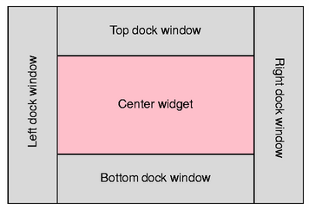
Creating Dock Windows - QDockWidget
Window docked into main window
Qt::DockWidgetArea enum
Left, Right, Top, Bottom dock areas
QMainWindow::setCorner(corner, area)
Sets area to occupy specified corner
QMainWindow::setDockOptions(options)
Specifies docking behavior (animated, nested, tabbed,...)
void MainWindow::createDockWidget() {
QDockWidget *dock = new QDockWidget(tr("Title"), this);
dock->setAllowedAreas(Qt::LeftDockWidgetArea);
QListWidget *widget = new QListWidget(dock);
dock->setWidget(widget);
addDockWidget(Qt::LeftDockWidgetArea, dock);

Slide 93
QMenu and Context Menus
Launch via event handler
void MyWidget::contextMenuEvent(event) {
m_contextMenu->exec(event->globalPos());
Or signal customContextMenuRequested()
Connect to signal to show context menu
Or via QWidget::actions() list
QWidget::addAction(action)
setContextMenuPolicy(Qt::ActionsContextMenu)
Displays QWidget::actions() as context menu

Slide 94
Typical APIs
QWidget
setWindowModified(...)
setWindowTitle(...)
addAction(...)
contextMenuEvent(...)
QMainWindow
setCentralWidget(...)
menuBar()
statusBar()
addToolbar(...)
addToolBarBreak()
addDockWidget(...)
setCorner(...)
setDockOptions(...)
QAction
setShortcuts(...)
setStatusTip(...)
signaltriggered()
QMenuBar
addMenu(...)
QToolbar
addAction(...)
QStatusBar
showMessage(...)
clearMessage()
addWidget(...)

Slide 95
Lab – Text Editor
Create a text editor with
load, save, quit
About and AboutQt
A QPlainTextEdit serves for editing the text.
Optional:
Show whether the file is dirty
Ask the user whether to save if file is dirty when application quits
Make sure also to ask when window is closed via window manager
Show the cursor position in the status bar
Position is determined by cursors block and column count
Lab: lab-texteditor

Slide 96
Settings

Slide 97
Persistent Settings - QSettings
Configure QSettings
QCoreApplication::setOrganizationName("MyCompany");
QCoreApplication::setOrganizationDomain("mycompany.com");
QCoreApplication::setApplicationName("My Application");
Typical usage
QSettings settings;
settings.setValue("group/value", 68);
int value = settings.value("group/value").toInt();
Values are stored as QVariant
Keys form hierarchies using '/’
Or use beginGroup(prefix) / endGroup()
value() excepts default value
settings.value("group/value", 68).toInt()
If value not found and default not specified
Invalid QVariant() returned

Slide 98
Restoring State of an Application
Store geometry of application
Restore geometry of application
void MainWindow::writeSettings() {
QSettings settings;
settings.setValue("MainWindow/size", size());
settings.setValue("MainWindow/pos", pos());
}
void MainWindow::readSettings() {
QSettings settings;
settings.beginGroup("MainWindow");
resize(settings.value("size", QSize(400, 400)).toSize());
move(settings.value("pos", QPoint(200, 200)).toPoint());
settings.endGroup();
}

Slide 99
Settings - Behind the Scenes
Stored in platform specific format
Unix :INI files
Windows: System registry
MacOS: CFPreferences API
Value lookup will search several locations
User-specific location
for application
for applications by organization
System-wide location
for application
for applications by organization
QSettings creation is cheap! Use on stack

Slide 100
Resources

Slide 101
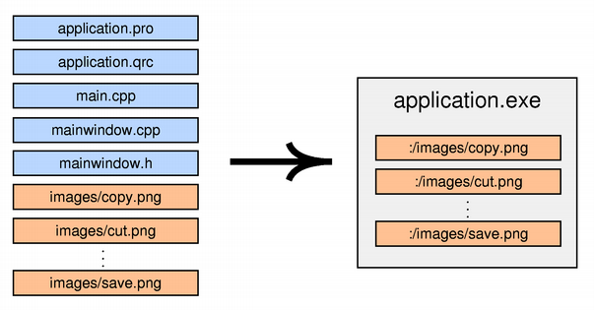
Resource System
Platform-independent mechanism for storing binary files
Not limited to images
Resource files stored in application's executable
Useful if application requires files
E.g. icons, translation files, sounds
Don't risk of losing files, easier deployment

Slide 102
Using Resources
Resources specified in .qrc file
Resources are accessible with ':’ prefix
Example: ":/images/cut.png”
Simply use resource path instead of file name
QIcon(":/images/cut.png")
To compile resource, edit .pro file
RESOURCES += application.qrc
qmake produces make rules to generate binary file
<!DOCTYPE RCC><RCC version="1.0">
<qresource>
<file>images/copy.png</file>
<file>images/cut.png</file>
...
</qresource>
</RCC>

Slide 103
Resource Specifics
Path Prefix
<qresource prefix="/myresources">
File accessible via ":/myresources/...”
Aliases
<file alias="cut.png">images/scissors.png</file>
File accessible via ":/cut.png"
Static Libraries and Resources
Need to force initialization
Q_INIT_RESOURCE(basename);
Loading resources at runtime
Use rcc to create binary and register resource
rcc -binary data.qrc -o data.rcc
QResource::registerResource("data.rcc")
Traverse resource tree using QDir(":/")

Slide 104
Lab – Upgrade Editor to Use Resources
Use your previous editor, to use Qt resource system for icons
Tip: You can use QtCreator to create QRC files

Slide 105
Translation for Developers

Slide 106
Internationalization (i18n)
This is by no means a complete guide!
Internationalization(i18n)
Designing applications to be adaptable to languages and regions without engineering changes.
Localization(l10n)
Adapting applications for region by adding components and translations
Qt supports the whole process:
QString supports unicode
On-screen texts (QObject::tr())
Number and date formats (QLocale)
Icons loading (Resource System)
Translation tool (Qt Linguist)
LTR and RTL text, layout and widgets (e.g. Arabic)
Plural handling (1 file vs. 2 files)

Slide 107
Text Translation
lupdate – scan C++ and .ui files for strings
Create/update .ts file
linguist – edit .ts file for adding translations
lrelease – read .ts and creates .qm file for release
QObject::tr() – mark translatable strings in C++ code
Combine with QString::arg() for dynamic text
setWindowTitle(tr("File: %1 Line: %2").arg(f).arg(l));
//: This comment is seen by translation staff
label->setText(tr("Name: %1 Date: %2”).arg(name, d.toString()));

Slide 108
Translation Process

Slide 109
Other Internationalization
Qt classes are locale aware
Numbers
QDate, QTime and QDateTime
qDebug() << QDate().toString(); // prints localized date
Use QKeySequence for shortcut values
action->setShortcut(QKeySequence::New);
action->setShortcut(QKeySequence(tr("Ctrl+N"));
QLocale::setDefault(QLocale::German); // de_DE
QLocale german; bool ok;
german.toDouble("1234,56", &ok); // ok == true
QLocale::setDefault(QLocale::C); // en_US
value = QString("1234.56").toDouble(&ok) // ok == true

Slide 110
Lab – Translate Editor to German
We use our existing editor
In the handout you will find a list of translation words
Germany country code is de
Tip: You can use Qt Linguist to edit translations

Slide 111
Deploying Qt Applications

Slide 112
Ways of Deploying
Static Linking
Results in stand-alone executable
+ Only few files to deploy
− Executables are large
− No flexibility
− You cannot deploy plugins
Shared Libraries
+ Can deploy plugins
+ Qt libs shared between applications
+ Smaller, more flexible executables
− More files to deploy
Qt is by default compiled as shared library
If Qt is pre-installed on system
Use shared libraries approach

Slide 113
Deployment
Shared Library Version
If Qt is not a system library
Need to redistribute Qt libs with application
Minimal deployment
Libraries used by application
Plugins used by Qt
Ensure Qt libraries use correct path to find Qt plugins
Static Linkage Version
Build Qt statically
$QTDIR/configure -static <your other options>
Specify required options (e.g. sqldrivers)
Link application against Qt
Check that application runs stand-alone
Copy application to machine without Qt and run it

Slide 114
Dialogs

Slide 115
Contents
Dialogs
Common Dialogs
Qt Designer

Slide 116
Objectives
Custom Dialogs
Modality
Inheriting QDialog
Dialog buttons
Predefined Dialogs
File, color, input and font dialogs
Message boxes
Progress dialogs
Wizard dialogs
Qt Designer
Design UI Forms
Using forms in your code
Dynamic form loading

Slide 117
Dialogs

Slide 118
Dialog Windows - QDialog
Base class of dialog window widgets
General Dialogs can have 2 modes
Modal dialog
Remains in foreground, until closed
Blocks input to remaining application
Example: Configuration dialog
Modeless dialog
Operates independently in application
Example: Find/Search dialog
MyDialog dialog(this);
dialog.setMyInput(text);
if(dialog.exec() == Dialog::Accepted) {
// exec blocks until user closes dialog

Slide 119
Modeless Dialog
Use show()
Displays dialog
Returns control to caller
void EditorWindow::find() {
if (!m_findDialog) {
m_findDialog = new FindDialog(this);
connect(m_findDialog, SIGNAL(findNext()), this,
SLOT(onFindNext()));
}
m_findDialog->show(); // returns immediately
m_findDialog->raise(); // on top of other windows
m_findDialog->activateWindow(); // keyboard focus
}

Slide 120
Custom Dialogs
Inherit from QDialog
Create and layout widgets
Use QDialogButtonBox for dialog buttons
Connect buttons to accept()/reject()
Override accept()/reject()
MyDialog::MyDialog(QWidget *parent) : QDialog(parent) {
m_label = new QLabel(tr("Input Text"), this);
m_edit = new QLineEdit(this);
m_box = new QDialogButtonBox( QDialogButtonBox::Ok |
QDialogButtonBox::Cancel, this);
connect(m_box, SIGNAL(accepted()), this, SLOT(accept()));
connect(m_box, SIGNAL(rejected()), this, SLOT(reject()));
... // layout widgets
}
void MyDialog::accept() { // customize close behaviour
if(isDataValid()) { QDialog::accept() }
}

Slide 121
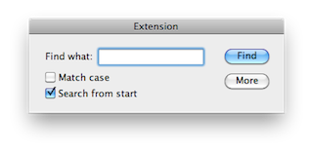
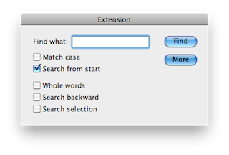
Other Dialog Topics
Deletion of dialogs
No need to keep dialogs around forever
Call QObject::deleteLater()
Or setAttribute(Qt::WA_DeleteOnClose)
Or override closeEvent()
Dialogs with extensions:
QWidget::show()/hide() used on extension
m_more = new QPushButton(tr("&More"));
m_more->setCheckable(true);
m_extension = new QWidget(this);
// add your widgets to extension
m_extension->hide();
connect(m_more, SIGNAL(toggled(bool)), m_extension,
SLOT(setVisible(bool)));

Slide 122
Common Dialogs

Slide 123
Asking for Files - QFileDialog
Allow users to select files or directories
Asking for a file name
QString fileName = QFileDialog::getOpenFileName(this, tr("Open File"));
if(!fileName.isNull()) {
// do something useful
}
QFileDialog::getOpenFileNames()
Returns one or more selected existing files
QFileDialog::getSaveFileName()
Returns a file name. File does not have to exist.
QFileDialog::getExistingDirectory()
Returns an existing directory.
setFilter("Image Files (*.png *.jpg *.bmp)")
Displays files matching the patterns

Slide 124
Showing Messages - QMessageBox
Provides a modal dialog for…
Informing the user
Asking a question and receiving an answer
Typical usage, questioning a user
QMessageBox::StandardButton ret = QMessageBox::question(parent, title, text);
if(ret == QMessageBox::Ok) {
// do something useful
}
Very flexible in appearance
Other convenience methods
QMessageBox::information(...)
QMessageBox::warning(...)
QMessageBox::critical(...)
QMessageBox::about(...)

Slide 125
Feedback on Progress - QProgressDialog
Provides feedback on the progress of a slow operation
Initialize with setValue(0)
Otherwise estimation of duration will not work
When operation progresses, check for cancel
QProgressDialog::wasCanceled()
Or connect to QProgressDialog::canceled()
To stay reactive call QApplication::processEvents()
QProgressDialog dialog("Copy", "Abort", 0, count, this);
dialog.setWindowModality(Qt::WindowModal);
for (int i = 0; i < count; i++) {
dialog.setValue(i);
if (dialog.wasCanceled()) { break; }
//... copy one file
}
dialog.setValue(count); // ensure set to maximum

Slide 126
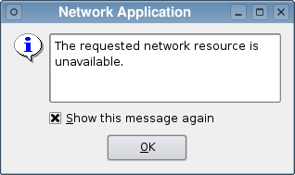
Providing Error Messages - QErrorMessage
Similar to QMessageBox with checkbox
Asks if message shall be displayed again
m_error = new QErrorMessage(this);
m_error->showMessage(message, type);
Messages will be queued
QErrorMessage::qtHandler()
Installs an error handler for debugging
Shows qDebug(), qWarning() and qFatal() messages in QErrorMessage box

Slide 127
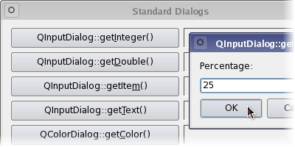
Other Common Dialogs
Asking for Input – QInputDialog
QInputDialog::getText(...)
QInputDialog::getInt(...)
QInputDialog::getDouble(...)
QInputDialog::getItem(...)
Selecting Color – QColorDialog
QColorDialog::getColor(...)
Selecting Font – QFontDialog
QFontDialog::getFont(...)

Slide 128
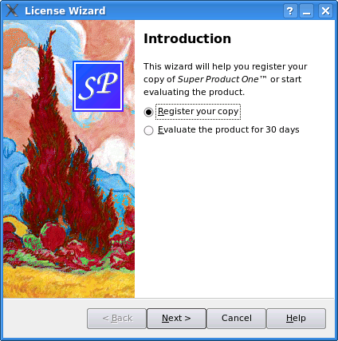
Guiding the User - QWizard
Input dialog
Consisting of sequence of pages
Purpose: Guide user through process
Page by page
Supports
Linear and non-linear wizards
Registering and using fields
Access to pages by ID
Page initialization and cleanup
Title, sub-title
Logo, banner, watermark, background
Each page is a QWizardPage
QWizard::addPage() adds page to wizard

Slide 129
Simple Wizard Example
QWizardPage *createIntroPage() {
QWizardPage *page = new QWizardPage;
page->setTitle("Introduction");
// create widgets and layout them return page;
return page;
}
QWizardPage *createRegistrationPage() { ... }
int main(int argc, char *argv[]) {
QApplication app(argc, argv);
QWizard wizard;
wizard.setWindowTitle("License Wizard");
wizard.addPage(createIntroPage());
wizard.addPage(createRegistrationPage());
wizard.show();
return app.exec();
}

Slide 130
Questions And Answers
When would you use a modal dialog, and when would you use a non-modal dialog?
When should you call exec() and when should you call show()?
Can you bring up a modal dialog, when a modal dialog is already active?
When do you need to keep widgets as instance variables?
What is the problem with this code:
QDialog *dialog = new QDialog(parent);
QCheckBox *box = new QCheckBox(dialog);

Slide 131
Lab – Custom Dialog
We create a simple value dialog
Shows int value
As slider
As spin box
Value must be < 50 to be accepted
A main window will show result
Has a slider, connected to dialog
Two buttons to launch dialog in modal and modeless mode
Lab: lab-dialog

Slide 132
Qt Designer

Slide 133
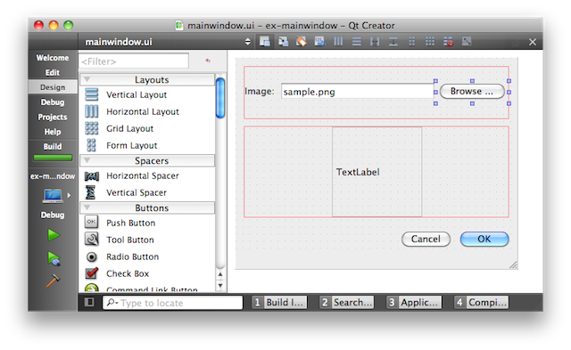
Qt Designer
Design UI forms visually
Visual Editor for
Signal/slot connections
Actions
Tab handling
Buddy widgets
Widget properties
Integration of custom widgets
Resource files

Slide 134
Designer Views

Slide 135




Designer's Editing Modes
Widget Editing
Change appearance of form
Add layouts
Edit properties of widgets
Signal and Slots Editing
Connect widgets together with signals & slots
Buddy Editing
Assign buddy widgets to label
Buddy widgets help keyboard focus handling correctly
Tab Order Editing
Set order for widgets to receive the keyboard focus

Slide 136

Designer UI Form Files
Form stored in .ui file
Format is XML
uic tool generates code
From myform.ui to ui_myform.h
Form ui file in project (.pro)
FORMS += mainwindow.ui
// ui_mainwindow.h
class Ui_MainWindow {
public:
QLineEdit *fileName;
... // simplified code
void setupUi(QWidget *) { /* setup widgets */ }
};

Slide 137
From .ui to C+

Slide 138

Qt Creator - Form Wizards
Add New..."Designer Form”
Or "Designer Form Class” (for C++ integration)

Slide 139

Naming Widgets
Place widgets on form
Edit objectName property
objectName defines member name in generated code

Slide 140

Form Layout in Designer
QFormLayout: Suitable for most input forms

Slide 141

Top-Level Layout
First layout child widgets
Finally select empty space and set top-level layout

Slide 142

Preview Widget in Preview Mode
Check that widget is nicely resizable

Slide 143
Code Integration - Header File
"Your Widget” derives from appropriate base class
*ui member encapsulate UI class
Makes header independent of designer generated code
// orderform.h
class Ui_OrderForm;
class OrderForm : public QDialog {
private: Ui_OrderForm *ui; // pointer to UI object
};

Slide 144
Code Integration - Implementation File
Default behavior in Qt Creator
// orderform.cpp
#include "ui_orderform.h"
OrderForm::OrderForm(QWidget *parent) :
QDialog(parent),
ui(new Ui_OrderForm)
{
ui->setupUi(this);
}
OrderForm::~OrderForm()
{
delete ui;
ui=0;
}

Slide 145
Signals and Slots in Designer
Widgets are available as public members
ui->fileName->setText("image.png")
Name based on widgets object name
You can set up signals & slots traditionally...
connect(ui->okButton, SIGNAL(clicked()), ...
Auto-connection facility for custom slots
Automatically connect signals to slots in your code
Based on object name and signal
void on_objectName_signal(parameters);
Example: on_okButton_clicked() slot
Qt Creator: right-click on widget and "Go To Slot”
Generates a slot using auto-connected name

Slide 146
Using Custom Widgets in Designer
Forms can be processed at runtime
Produces dynamically generated user interfaces
Disadvantages
Slower, harder to maintain
Risk: .ui file not available at runtime
Loading .ui file
QUiLoader loader;
QFile file("forms/textfinder.ui");
file.open(QFile::ReadOnly);
QWidget *formWidget = loader.load(&file, this);
Locate objects in form
ui_okButton = qFindChild<QPushButton*>(this, "okButton");

Slide 147

Lab – Designer Order Form
Create an order form dialog
With fields for price, quantity and total.
Total field updates itself to reflect quantity and price entered
Lab: lab-orderform

Slide 148
Model/View Framework

Slide 149
Contents
Model/View Concept
Showing Simple Data
Proxy Models
Custom Models

Slide 150
Objectives
Using Model/View
Introducing to the concepts of model-view
Showing Data using standard item models
Understand the limitations of standard item models
How to interface your model with a data backend
Understand what are proxy models and how to use them
Custom Models
Writing a simple read-only custom model

Slide 151
Model/View Concept

Slide 152
Why Model/View?
Isolated domain-logic
From input and presentation
Makes Components Independent
For Development
For Testing
For Maintenance
Foster Component Reuse
Reuse of Presentation Logic
Reuse of Domain Model

Slide 153
Model/View Components
Renders data items
View
Delegate
Fetches data items
Notifies about data changes
Model
Stores changed data items
Data
Demo: ex-simple

Slide 154

Model Structures

Slide 155


Display the Structure - View Classes
QtQuick ItemView
Abstract base class for scrollable views
QtQuick ListView
Items of data in a list
QtQuick GridView
Items of data in a grid
QtQuick PathView
Items of data along a specified path

Slide 156
Adapts the Data - Model Classes
QAbstractItemModel
Abstract interface of models
Abstract Item Models
Implement to use
Ready-Made Models
Convenient to use
Proxy Models
Reorder/filter/sort your items

Slide 157
Data - Model - View Relationships
Standard Item Model
Data+Model combined
View is separated
Model is your data
Custom Item Models
Model is adapter to data
View is separated

Slide 158
Addressing Data - QModelIndex
Refers to item in model
Contains all information to specify location
Located in given row and column
May have a parent index
QModelIndex API
row() - row index refers to
column() – column index refers to
parent() – parent of index
Or QModelIndex() if no parent
isValid()
Valid index belongs to a model
Valid index has non-negative row and column numbers
model() – the model index refers to
data( role ) - data for given role

Slide 159


QModelIndex in Table/Tree Structures
Rows and columns
Item location in table model
Item has no parent (parent.isValid() == false)
indexA = model->index(0, 0, QModelIndex());
indexB = model->index(1, 1, QModelIndex());
indexC = model->index(2, 1, QModelIndex());
Parents, rows, and columns
Item location in tree model
indexA = model->index(0, 0, QModelIndex());
indexC = model->index(2, 1, QModelIndex());
// asking for index with given row, column and parent
indexB = model->index(1, 0, indexA);

Slide 160

Item and Item Roles
Item performs various roles
For other components (delegate, view,...)
Supplies different data
For different situations
Example:
Qt::DisplayRole used display string in view
Asking for data
QVariant value = model->data(index, role);
// Asking for display text
QString text = model->data(index, Qt::DisplayRole).toString()
Standard roles
Defined by Qt::ItemDataRole

Slide 161
Mapping Item Roles from/to QML
Item Roles in C++
// Asking for display text
QString text = model->data(index, Qt::DisplayRole).toString()
Item properties in QML
onCurrentIndexChanged: { var text = model.get(index).display
}
Default mappings
Qt::DisplayRole in C++ is display in QML
Qt::DecorationRole in C++ is decoration in QML
Add additional mappings by re-implementing
QAbstractItemModel::roleNames()

Slide 162
Exporting Models to QML
Export model instance
Create model instance in C++
Set as a context property on the view's engine
CustomModel *model = new CustomModel;
QQuickView view;
view.engine()->rootContext("_model", model);
Use in QML by id
ListView { model: _model }
Export model type
Register custom model class with QML type system
qmlRegisterType<CustomModel>("Models", 1, 0, "CustomModel");
Use in QML like any other QML element
import Models 1.0
ListView {
model: CustomModel {}
}

Slide 163
Recap of Model/View Concept
Model Structures
List, Table and Tree
Components
Model - Adapter to Data
View - Displays Structure
Delegate – Paints Item
Index – Location in Model
Views
ListView
GridView
PathView
Models
QAbstractItemModel
Other Abstract Models
Ready-Made Models
Proxy Models
Index
row(), column(), parent()
data( role )
model()
Item Role
Qt::DisplayRole
Standard Roles in
Qt::ItemDataRoles

Slide 164
Showing Simple Data

Slide 165
QStandardItemModel - Convenient Model
QStandardItemModel
Classic item-based approach
Only practical for small sets of data
model = new QStandardItemModel(parent);
item = new QStandardItem("A (0,0)");
model->appendRow(item);
model->setItem(0, 1, new QStandardItem("B (0,1)"));
item->appendRow(new QStandardItem("C (0,0)"));
"B(0,1)” and "C(0,0)” – Not visible. (list view is only 1-dimensional)
Demo: ex-QStandardItemModel

Slide 166

Meet the City Engine
Our Demo Model
62 most populous cities of the world
Data in CSV file
Data Columns
City | Country | Population | Area | Flag
Implemented as data backend
Internal implementation is hidden
Code in CityEngine class

Slide 167
Our Backend CityEngine API
public CityEngine : public QObject {
// returns all city names
QStringList cities() const;
// returns country by given city name
QString country(const QString &cityName) const;
// returns population by given city name
int population(const QString &cityName) const;
// returns city area by given city name
qreal area(const QString &cityName) const;
// returns country flag by given country name
QIcon flag(const QString &countryName) const;
// returns all countries
QStringList countries() const;
// returns city names filtered by country
QStringList citiesByCountry(const QString& countryName) const;
};

Slide 168

Lab: Standard Item Model for CityEngine
Implement setupModel() in citymodel.cpp
Display cities grouped by countries
Lab: lab-cities-standarditem

Slide 169
Proxy Models

Slide 170
Proxy Model - QSortFilterProxyModel
QSortFilterProxyModel
Transforms structure of source model
Maps indexes to new indexes
view = new QQuickView(parent);
// insert proxy model between model and view
proxy = new QSortFilterProxyModel(parent);
proxy->setSourceModel(model);
view->engine()->rootContext()->setContextProperty("_proxy", proxy);
Note: Need to load all data to sort or filter

Slide 171
Sorting/Filtering - QSortFilterProxyModel
Filter with Proxy Model
// filter column 1 by "India"
proxy->setFilterWildcard("India");
proxy->setFilterKeyColumn(1);
Sorting with Proxy Model
// sort column 0 ascending
proxy->sort(0, Qt::AscendingOrder);
Filter via TextInput’s signal
TextInput {
onTextChanged: _proxy.setFilterWildcard(text)
}
Demo: ex-sortfiltertableview

Slide 172
Custom Models

Slide 173
Implementing a Model
Variety of classes to choose from
QAbstractListModel
One dimensional list
QAbstractTableModel
Two-dimensional tables
QAbstractItemModel
Generic model class
QStringListModel
One-dimensional model
Works on string list
QStandardItemModel
Model that stores the data

Slide 174
Step 1: Read Only List Model
class MyModel: public QAbstractListModel
{
public:
// return row count for given parent
int rowCount( const QModelIndex &parent) const;
// return data, based on current index and requested role
QVariant data( const QModelIndex &index,
int role = Qt::DisplayRole) const;
};
Demo: ex-stringlistmodel

Slide 175
Step 2: Suppling Header Information
QVariant MyModel::headerData(int section,
Qt::Orientation orientation,
int role) const
{
// return column or row header based on orientation
}
Demo: ex-stringlistmodel-2

Slide 176
Step 3: Enabling Editing
// should contain Qt::ItemIsEditable
Qt::ItemFlags MyModel::flags(const QModelIndex &index) const
{
return QAbstractListModel::flags() | Qt::ItemIsEditable;
}
// set role data for item at index to value
bool MyModel::setData( const QModelIndex & index,
const QVariant & value,
int role = Qt::EditRole)
{
... = value; // set data to your backend
emit dataChanged(topLeft, bottomRight); // if successful
}
Demo: ex-stringlistmodel-3

Slide 177
Step 4: Row Manipulation
// insert count rows into model before row
bool MyModel::insertRows(int row, int count, parent)
{
beginInsertRows(parent, first, last);
// insert data into your backend
endInsertRows();
}
// removes count rows from parent starting with row
bool MyModel::removeRows(int row, int count, parent)
{
beginRemoveRows(parent, first, last);
// remove data from your backend
endRemoveRows();
}
Demo: ex-stringlistmodel-4

Slide 178
Lab – City List Model
Please implement a City List Model
Given:
Start with solution of modelview/lab-cities-standarditem
Your Task:
Rebase CityModel to QAbstractListModel
Optional
Make the model editable
Enable adding / removing cities
Lab: sol-cities-standarditem

Slide 179
Delegates and Views

Slide 180
Contents
Delegates
Editing item data
Data Widget Mapper
Drag and Drop
Custom Tree Model

Slide 181
Objectives
Custom Model/View
Editable Models
Custom Delegates
Using Data Widget Mapper
Custom Proxy Models
Drag and Drop

Slide 182
Delegates

Slide 183
Item Delegates
QAbstractItemDelegate subclasses
Control appearance of items in views
Provide edit and display mechanisms
QItemDelegate, QStyledItemDelegate
Default delegates
Suitable in most cases
Modelneedstoprovideappropriatedata
When to go for Custom Delegates?
More control over appearance of items

Slide 184

Item Appearance
Data table shown has no custom delegate
No need for custom delegate!
Use Qt::ItemRole to customize appearance

Slide 185

Delegate from QAbstractItemDelegate
class BarGraphDelegate : public QAbstractItemDelegate {
public:
void paint(QPainter *painter,
const QStyleOptionViewItem &option,
const QModelIndex &index) const;
QSize sizeHint(const QStyleOptionViewItem &option,
const QModelIndex &index) const;
};

Slide 186
Integer Value - Bar Graph Delegate
void BarGraphDelegate::paint(painter, option, index) const
{
if(index.data(Qt::EditRole).userType() == QVariant::Int) {
int value = index.data(Qt::EditRole).toInt();
// prepare rect with a width proportional to value
QRect rect(option.rect.adjusted(4,4,-4,-4));
rect.setWidth(rect.width()*value/MAX_VALUE);
// draw the value bar
painter->fillRect(rect, QColor("steelblue").lighter(value));
painter->drawText(option.rect, index.data().toString());
}
}
QSize BarGraphDelegate::sizeHint(option, index) const
{
Q_UNUSED(index)
return QSize(MIN_BAR_WIDTH, option.fontMetrics.height());
}
Demo: ex-bargraphdelegate

Slide 187
Editing Item Data

Slide 188

An Editor Delegate
Provides QComboBox
For editing a series of values
class CountryDelegate : public QItemDelegate
{
public:
// returns editor for editing data
QWidget *createEditor( parent, option, index ) const;
// sets data from model to editor void
setEditorData( editor, index ) const;
// sets data from editor to model
void setModelData( editor, model, index ) const;
// updates geometry of editor for index
void updateEditorGeometry( editor, option, index ) const;
};

Slide 189
Providing an Editor
Create editor by index
Set data to editor
QWidget *CountryDelegate::createEditor( ... ) const {
QComboBox *editor = new QComboBox(parent);
editor->addItems( m_countries );
return editor;
}
void CountryDelegate::setEditorData( ... ) const {
QComboBox* combo = static_cast<QComboBox*>( editor );
QString country = index.data().toString();
int idx = m_countries.indexOf( country );
combo->setCurrentIndex( idx );
}

Slide 190
Submitting Data to the Model
When user finished editing
View asks delegate to store data into model
If editor has finished editing
void CountryDelegate::setModelData(editor, model, index) const {
QComboBox* combo = static_cast<QComboBox*>( editor );
model->setData( index, combo->currentText() );
}
// copy edtitors data to model
emit commitData( editor );
// close/destroy editor
emit closeEditor( editor, hint );
// hint: indicates action performed next to editing

Slide 191
Updating the Editor's Geometry
Delegate manages editor's geometry
View provides geometry information
QStyleOptionViewItem
.
Case of multi-index editor
Position editor in relation to indexes
void CountryDelegate::updateEditorGeometry( ... ) const {
// don't allow to get smaller than editors sizeHint()
QSize size = option.rect.size().expandedTo(editor->sizeHint());
QRect rect(QPoint(0,0), size);
rect.moveCenter(option.rect.center());
editor->setGeometry( rect );
}
Demo: ex-editordelegate

Slide 192
Setting Delegates on Views
view->setItemDelegate( ... )
view->setItemDelegateForColumn( ... )
view->setItemDelegateForRow(... )

Slide 193

Type-Based Delegates
Our color editor widget
Registering editor for type QVariant::Color
class ColorListEditor : public QComboBox {
...
};
QItemEditorFactory *factory = new QItemEditorFactory;
QItemEditorCreatorBase *creator = new
QStandardItemEditorCreator<ColorListEditor>();
// registers item editor creator given type of data
factory->registerEditor(QVariant::Color, creator);
// new and existing delegates will use new factory
QItemEditorFactory::setDefaultFactory(factory);

Slide 194
Data Widget Mapper

Slide 195
Data Widget Mapper- QDataWidgetMapper
Maps model sections to widgets
Widgets updated, when current index changes
Orientation
Horizontal => Data Columns
Vertical => Data Rows

Slide 196
Using QDataWidgetMapper
Mapping Setup
Track Navigation
mapper = new QDataWidgetMapper(this);
mapper->setOrientation(Qt::Horizontal);
mapper->setModel(model);
// mapper->addMapping( widget, model-section)
mapper->addMapping(nameEdit, 0);
mapper->addMapping(addressEdit, 1);
mapper->addMapping(ageSpinBox, 2);
// populate widgets with 1st row
mapper->toFirst();
connect(nextButton, SIGNAL(clicked()), mapper, SLOT(toNext()));
connect(previousButton, SIGNAL(clicked()), mapper, SLOT(toPrevious()));

Slide 197
Mapped Property - The USER Property
USER indicates property is user-editable property
Only one USER property per class
Used to transfer data between the model and the widget
addMapping(lineEdit, 0); // uses "text" user property
addMapping(lineEdit, 0, "inputMask"); // uses named property
class QLineEdit : public QWidget
{
...
Q_PROPERTY(QString text
READ text WRITE setText NOTIFY textChanged
USER true) // USER property
...
};

Slide 198
Drag and Drop

Slide 199
Drag and Drop for Views
Enable the View
Model has to provide support for drag and drop operations
Model needs to support actions
For example Qt::MoveAction
Implement MyModel::removeRows( ... )
// enable item dragging
view->setDragEnabled(true);
// allow to drop internal or external items
view->setAcceptDrops(true);
// show where dragged item will be dropped
view->setDropIndicatorShown(true);
Qt::DropActions MyModel::supportedDropActions() const
{
return Qt::CopyAction | Qt::MoveAction;
}

Slide 200
Drag and Drop with QStandardItemModel
Setup of Model
Model is ready by default
model->mimeTypes()
"application/x-qabstractitemmodeldatalist”
"application/x-qstandarditemmodeldatalist”
model->supportedDragActions()
QDropEvent::Copy | QDropEvent::Move
model->supportedDropActions()
QDropEvent::Copy | QDropEvent::Move
item = new QStandardItem("Drag and Droppable Item");
// drag by default copies item
item->setDragEnabled(true);
// drop mean adding dragged item as child
item->setDropEnabled(true);
Demo: ex-dndlist

Slide 201
Drag and Drop on QAbstractItemModel
class MyModel : public QAbstractItemModel {
public:
// actions supported by the data in this model
Qt::DropActions supportedDropActions() const;
// for supported index return Qt::ItemIs(Drag|Drop)Enabled
Qt::ItemFlags flags(const QModelIndex &index) const;
// returns list of MIME types that are supported
QStringList QAbstractItemModel::mimeTypes() const;
// returns object with serialized data in mime formats
QMimeData *mimeData(const QModelIndexList &indexes) const;
// true if data and action can be handled, otherwise false
bool dropMimeData(const QMimeData *data, Qt::DropAction action,
int row, int column, const QModelIndex &parent);
};
Demo: ex-drag-and-drop

Slide 202
Custom Tree Models

Slide 203
A Custom Tree Model in 5 Steps
Read-Only Model
Editable Model
Insert-Remove Model
Lazy Model
Drag and Drop Model

Slide 204
A (Simple) Node Structure
class Node {
public:
Node(const QString& aText="No Data", Node *aParent=0);
~Node();
QVariant data() const;
public:
QString text;
Node *parent;
QList<Node*> children;
};
Demo: ex-treemodel

Slide 205
Read-Only Model
class ReadOnlyModel : public QAbstractItemModel
{
public:
...
QModelIndex index( row, column, parent ) const;
QModelIndex parent child ) const;
int rowCount( parent ) const;
int columnCount( parent ) const;
QVariant data( index, role) const;
protected: // important helper methods
QModelIndex indexForNode(Node *node) const;
Node* nodeForIndex(const QModelIndex &index) const;
int rowForNode(Node *node) const;
};

Slide 206
Editable Model
class EditableModel : public ReadOnlyModel {
public:
...
bool setData( index, value, role );
Qt::ItemFlags flags( index ) const;
};

Slide 207
Insert Remove Model
class InsertRemoveModel : public EditableModel {
public:
...
void insertNode(Node *parentNode, int pos, Node *node);
void removeNode(Node *node);
void removeAllNodes();
};

Slide 208
Lazy Model
class LazyModel : public ReadOnlyModel {
public:
...
bool hasChildren( parent ) const;
bool canFetchMore( parent ) const;
void fetchMore( parent );
};

Slide 209
DnD Model
class DndModel : public InsertRemoveModel {
public:
...
Qt::ItemFlags flags( index ) const;
Qt::DropActions supportedDragActions() const;
Qt::DropActions supportedDropActions() const;
QStringList mimeTypes() const;
QMimeData *mimeData( indexes ) const;
bool dropMimeData(data, dropAction, row, column, parent);
bool removeRows(row, count, parent);
bool insertRows(row, count, parent);
};
Demo: ex-treemodel

Slide 210
GraphicsView

Slide 211
Contents
Using GraphicsView Classes
Coordinate Systems and Transformations
Creating Custom Items

Slide 212
Objectives
Using QGraphicsView-related classes
Coordinate Schemes, Transformations
Extending items
Event handling
Painting
Boundaries

Slide 213
Using GraphicsView Classes

Slide 214
GraphicsView Framework
Provides:
A surface for managing interactive 2D graphical items
A view widget for visualizing the items
Uses MVC paradigm
Resolution Independent
Animation Support
Fast item discovery, hit tests, collision detection
Using Binary Space Partitioning (BSP) tree indexes
Can manage large numbers of items (tens of thousands)
Supports zooming, printing and rendering

Slide 215

Hello World
#include <QtWidgets>
int main(int argc, char **argv)
{
QApplication app(argc, argv);
QGraphicsView view;
QGraphicsScene *scene = new QGraphicsScene(&view);
view.setScene(scene);
QGraphicsRectItem *rect = new QGraphicsRectItem(-10, -10, 120, 50);
scene->addItem(rect);
QGraphicsTextItem *text = scene->addText("Hello World!");
view.show();
return app.exec();
}
Demo: ex-helloworld

Slide 216

UML Relationship
QGraphicsScene is:
A "model” for QGraphicsView
A "container” for QGraphicsItems

Slide 217
QGraphicsScene
Container for Graphic Items • Items can exist in only one scene at a time
Propagates events to items
Manages Collision Detection
Supports fast item indexing
Manages item selection and focus
Renders scene onto view
z-order determines which items show up in front of others

Slide 218
QGraphicsScene Important Methods
addItem()
Add an item to the scene
(remove from previous scene if necessary)
Also addEllipse(), addPolygon(), addText(), etc.
items()
Returns items intersecting a particular point or region
selectedItems()
Returns list of selected items
sceneRect()
Bounding rectangle for the entire scene
QGraphicsEllipseItem *ellipse = scene->addEllipse(-10, -10, 120, 50);
QGraphicsTextItem *text = scene->addText("Hello World!");

Slide 219
QGraphicsView
Scrollable widget view port onto the scene
Zooming, rotation, and other transformations
Translates input events (from the View) into QGraphicsSceneEvents
Maps coordinates between scene and viewport
Provides "level of detail” information to items
Supports OpenGL

Slide 220
QGraphicsView Important Methods
setScene()
Sets the QGraphicsScene to use
setRenderHints()
antialiasing, smooth pixmap transformations, etc.
centerOn()
Takes a QPoint or a QGraphicsItem as argument
Ensures point/item is centered in View
mapFromScene(), mapToScene()
Map to/from scene coordinates
scale(), rotate(), translate(), matrix()
transformations

Slide 221
QGraphicsItem
Abstract base class: basic canvas element
Supports parent/child hierarchy
Easy to extend or customize concrete items:
QGraphicsRectItem, QGraphicsPolygonItem, QGraphicsPixmapItem, QGraphicsTextItem, etc.
SVG Drawings, other widgets
Items can be transformed:
move, scale, rotate
Using local coordinate systems
Supports Drag and Drop similar to QWidget

Slide 222

Concrete QGraphicsItem Types
Demo: ex-concreteitems

Slide 223
QGraphicsItem Important Methods
pos()
Get the item's position in scene
moveBy()
Moves an item relative to its own position.
zValue()
Get a Z order for item in scene
show(), hide() – set visibility
setEnabled(bool) - disabled items can not take focus or receive events
setFocus(Qt::FocusReason) - sets input focus.
setSelected(bool)
select/deselect an item
Typically called from QGraphicsScene::setSelectionArea()

Slide 224
Select, Focus, Move
QGraphicsItem::setFlags()
Determines which operations are supported on an item
QGraphicsItemFlags
QGraphicsItem::ItemIsMovable
QGraphicsItem::ItemIsSelectable
QGraphicsItem::ItemIsFocusable
item->setFlags(QGraphicsItem::ItemIsMovable |
QGraphicsItem::ItemIsSelectable);

Slide 225

Groups of Items
Any QGraphicsItem can have children
QGraphicsItemGroup is an invisible item for grouping child items
To group child items in a box with an outline (for example), use a QGraphicsRectItem
Try dragging boxes in demo:
Demo: ex-concreteitems

Slide 226
Parents and Children
Parent propagates values to child items:
setEnabled()
setFlags()
setPos()
setOpacity()
etc...
Enables composition of items.

Slide 227
Coordinate System and Transformations

Slide 228

Coordinate Systems
Each View and Item has its own local coordinate system

Slide 229
Coordinates
Coordinates are local to an item
Logical coordinates, not pixels
Floating point, not integer
Without transformations, 1 logical coordinate = 1 pixel.
Items inherit position and transform from parent
zValue is relative to parent
Item transformation does not affect its local coordinate system
Items are painted recursively
From parent to children
In increasing zValue order

Slide 230
QTransform
Coordinate systems can be transformed using Qtransform
QTransform is a 3x3 matrix describing a linear transformation from (x, y) to (xt, yt)
m₁₃ and m₂₃
Control perspective transformations
col1 | col2 | col3
m₁₁ | m₁₂ | m₁₃
m₂₁ | m₂₂ | m₂₃
m₃₁ | m₃₂ | m₃₃
xt = m₁₁*x + m₂₁*y + m₃₁
yt = m₂₂*y + m₁₂*x + m₃₃
if projected:
wt = m₁₃*x + m₂₃*y + m₃₃
xt /= wt
yt /= wt

Slide 231

Common Transformations
Commonly-used convenience functions:
scale()
rotate()
shear()
translate()
Saves you the trouble of defining transformation matrices
rotate() takes optional 2nd argument: axis of rotation.
Z axis is "simple 2D rotation”
Non-Z axis rotations are "perspective” projections.

Slide 232
View Transformations
setTransformationAnchor()
An anchor is a point that remains fixed before/after the transform.
AnchorViewCenter: (Default) The center point remains the same
AnchorUnderMouse: The point under the mouse remains the same
NoAnchor: Scrollbars remain unchanged.
t = QTransform(); // identity matrix
t.rotate(45, Qt::ZAxis); // simple rotate
t.scale(1.5, 1.5) // scale by 150%
view->setTransform(t); // apply transform to entire view

Slide 233
Item Transformations
QGraphicsItem supports same transform operations:
setTransform(), transform()
rotate(), scale(), shear(), translate()
An item's effective transformation:
The product of its own and all its ancestors' transformations
TIP: When managing the transformation of items, store the desired rotation, scaling etc. in member variables and build a QTransform from the identity transformation when they change. Don't try to deduce values from the current transformation and/or try to use it as the base for further changes.

Slide 234
Zooming
Zooming is done with view->scale()
void MyView::zoom(double factor)
{
double width = matrix().mapRect(QRectF(0, 0, 1, 1)).width();
width *= factor;
if ((width < 0.05) || (width > 10))
return;
scale(factor, factor);
}

Slide 235
Mapping between Coordinate Systems
Mapping methods are overloaded for QPolygonF, QPainterPath etc.
mapFromScene(const QPointF&):
Maps a point from scene coordinates to item coordinates. Inverse: mapToScene(const QPointF&)
mapFromItem(const QGraphicsItem*, const QPointF&)
Maps a point from another item's coordinate system to this item's .Inverse: mapToItem(const QGraphicsItem*, const QPointF&).
Special case: mapFromParent(constQPointF&).

Slide 236
Ignoring Transformations
Sometimes we don't want particular items to be transformed before display.
View transformation can be disabled for individual items.
Used for text labels in a graph that should not change size when the graph is zoomed.
item->setFlag( QGraphicsItem::ItemIgnoresTransformations);

Slide 237

Transforms Demo
Demo: ex-transformination

Slide 238
Creating Custom Items

Slide 239
Extending QGraphicsItem
QGraphicsItem pure virtual methods (required overrides):
void paint()
Paints contents of item in local coordinates
QRectF boundingRect()
Returns outer bounds of item as a rectangle
Called by QGraphicsView to determine what regions need to be re-drawn
QPainterPath shape() – shape of item
Used by contains() and collidesWithPath() for collision detection
Defaults to boundingRect() if not implemented

Slide 240

Boundaries

Slide 241
Painting Items
Item is in complete control of drawing itself
Use standard QPainter drawing methods
QPen, QBrush, pixmaps, gradients, text, etc.
No background to draw
Dynamic boundary and arbitrary shape
Polygon, curved, non-contiguous, etc.

Slide 242

Custom Item example
class PendulumItem : public QGraphicsItem {
public:
QRectF boundingRect() const;
void paint(QPainter* painter, const QStyleOptionGraphicsItem* option,
QWidget* widget);
};

Slide 243
paint() and boundingRect()
boundingRect() must take the pen width into consideration
QRectF PendulumItem::boundingRect() const {
return QRectF(-20.0 - PENWIDTH/2.0, -PENWIDTH/2.0,
40.0 + PENWIDTH, 140.0 + PENWIDTH );
}
void PendulumItem::paint( QPainter* painter,
const QStyleOptionGraphicsItem*, QWidget*) {
painter->setPen( QPen( Qt::black, PENWIDTH ) );
painter->drawLine(0,0,0,100);
QRadialGradient g( 0, 120, 20, -10, 110 );
g.setColorAt( 0.0, Qt::white );
g.setColorAt( 0.5, Qt::yellow );
g.setColorAt( 1.0, Qt::black );
painter->setBrush(g);
painter->drawEllipse(-20, 100, 40, 40);
}

Slide 244
Choosing a boundingRect()
boundingRect()
Influences drawing code
Influences "origin” of item transforms
i.e. for Pendulum that swings:
Good origin is non-weighted end of line
Can rotate around(0,0) without translation

Slide 245
QGraphicsItemGroup
Easier approach to making a Pendulum:
Extend QGraphicsItemGroup
Use other concrete items as elements, add as children
No need to override paint() or shape()
PendulumItem::PendulumItem(QGraphicsItem* parent) :
QGraphicsItemGroup(parent) {
m_line = new QGraphicsLineItem( 0,0,0,100, this);
m_line->setPen( QPen( Qt::black, 3 ) );
m_circle = new QGraphicsEllipseItem( -20, 100, 40, 40, this );
m_circle->setPen( QPen(Qt::black, 3 ));
QRadialGradient g( 0, 120, 20, -10, 110 );
g.setColorAt( 0.0, Qt::white );
g.setColorAt( 0.5, Qt::yellow );
g.setColorAt( 1.0, Qt::black );
m_circle->setBrush(g);
}
Demo: ex-pendelum

Slide 246
Event Handling
QGraphicsItem::sceneEvent(QEvent*)
Receives all events for an item
Similar to QWidget::event()
Specific typed event handlers:
keyPressEvent(QKeyEvent*)
mouseMoveEvent(QGraphicsSceneMouseEvent*)
wheelEvent(QGraphicsSceneWheelEvent*)
mousePressEvent(QGraphicsSceneMouseEvent*)
contextMenuEvent(QGraphicsSceneContextMenuEvent*)
dragEnterEvent(QGraphicsSceneDragDropEvent*)
focusInEvent(QFocusEvent*)
hoverEnterEvent(QGraphicsSceneHoverEvent*)
When overriding mouse event handlers:
Make sure to call base-class versions, too. Without this, the item select, focus, move behavior will not work as expected.

Slide 247
Event Handler Examples
void MyView::wheelEvent(QWheelEvent *event)
{
double factor = 1.0 + (0.2 * qAbs(event->delta()) / 120.0);
if (event->delta() > 0) zoom(factor);
else zoom(1.0/factor);
}
void MyView::keyPressEvent(QKeyEvent *event)
{
switch (event->key()) {
case Qt::Key_Plus:
zoom(1.2);
break;
case Qt::Key_Minus:
zoom(1.0/1.2);
break;
default:
QGraphicsView::keyPressEvent(event);
}
}

Slide 248
Collision Detection
Determines when items’ shapes intersect
Two methods for collision detection:
collidesWithItem(QGraphicsItem* other)
collidingItems(Qt::ItemSelectionMode)
shape()
Returns QPainterPath used for collision detection
Must be overridden properly
items()
Overloaded forms take QRectF, QPolygonF, QPainterPath
Return items found in rect/polygon/shape

Slide 249

Lab – Corner Drag Button
Definea QGraphicsItem which can display an image, and has at least 1 child item, that is a "corner drag" button, permitting the user to click and drag the button, to resize or rotate the image.
Start with the handout, provided in lab-cornerdrag
Further details are in the readme.txt in the same directory.

Slide 250
Widgets in a Scene

Slide 251

Widgets in a Scene

Slide 252
Items Are not Widgets
QGraphicsItem:
Lightweight compared to QWidget
No signals/slots/properties
Scenes can easily contain thousands of Items
Uses different QEvent sub-hierarchy (derived from QGraphicsSceneEvent)
Supports transformations directly
QWidget:
Derived from QObject (less light-weight)
Supports signals, slots, properties, etc.
Can be embedded in a QGraphicsScene with a QGraphicsProxyWidget

Slide 253

QGraphicsWidget
Advanced functionality graphics item
Provides signals/slots, layouts, geometry, palette, etc.
Not a QWidget
Base class for QGraphicsProxyWidget

Slide 254
QGraphicsProxyWidget
QGraphicsItem that can embed a QWidget in a QGraphicsScene
Handles complex widgets like QFileDialog
Takes ownership of related widget
Synchronizes states/properties:
visible, enabled, geometry, style, palette, font, cursor, sizeHint, windowTitle, etc.
Proxies events between Widget and GraphicsView
If either (widget or proxy) is deleted, the other is also!
Widget must not already have a parent
Only top-level widgets can be added to a scene

Slide 255
Embedded Widget Example
#include <QtWidgets>
int main(int argc, char **argv)
{
QApplication app(argc, argv);
QCalendarWidget *calendar = new QCalendarWidget;
QGraphicsScene scene;
QGraphicsProxyWidget *proxy = scene.addWidget(calendar);
QGraphicsView view(&scene);
view.show();
return app.exec();
}

Slide 256
QGraphicsLayout
For layout of QGraphicsLayoutItem (+derived) classes in QGraphicsView
Concrete classes:
QGraphicsLinearLayout: equivalent to QBoxLayout, arranges items horizontally or vertically
QGraphicsGridLayout: equivalent to QGridLayout, arranges items in a grid
QGraphicsWidget::setLayout() - set layout for child items of this QGraphicsWidget

Slide 257

Lab: Widgets in a Scene
Starting with the lab-mapviewer handout, add zooming controls.
Suggested widgets:
QPushButtons for +/-
QSlider for selecting zoom level directly.
Use QGraphicsLayout to layout the widgets
Make the mouse work like a "hand-grab” tool on drag, so we can see different zoomed areas.

Slide 258
Drag and Drop

Slide 259
Drag and Drop
Items can be:
Dragged
Dropped onto other items
Dropped onto scenes
For handling empty drop areas

Slide 260
Start Drag
Starting an item drag is similar to dragging from a QWidget.
Override event handlers:
mousePressEvent()
mouseMoveEvent()
In mouseMoveEvent(), decide if drag started? If so:
Create a QDrag instance
Attach a QMimeData to it
See section on Drag and Drop for QMimeData info
Call QDrag::exec()
Function returns when user drops
Does not block event loop

Slide 261
Drop on a Scene
Override QGraphicsScene::dropEvent()
To accept drop:
acceptProposedAction()
setDropAction(Qt::DropAction); accept();
Override QGraphicsScene::dragMoveEvent()
Optional overrides:
dragEnterEvent(), dragLeaveEvent()

Slide 262
startDrag() Example
void startDrag( Qt::DropActions supportedActions ) {
if ( selectedItems().size()>0 ) {
QListWidgetItem *item = selectedItems()[0];
QDrag* drag = new QDrag( this );
QMimeData *mimeData = new QMimeData; [...]
QGraphicsItem* gitem = DiagramItem::createItem(
item->toolType() );
mimeData->setData( "application/x-qgraphicsitem-ptr",
QByteArray::number( ( qulonglong )gitem ) );
drag->setMimeData( mimeData );
QPixmap pix = item->icon().pixmap( 111,111 );
drag->setPixmap( pix );
drag->setHotSpot( pix.rect().center() );
if ( drag->exec(supportedActions) == Qt::IgnoreAction ) {
delete gitem; // drag cancelled, must delete item
}
Demo: ex-draganddrop

Slide 263
dropEvent() on a Scene
void DiagramScene::dropEvent( QGraphicsSceneDragDropEvent* event) {
if (event->mimeData()->hasFormat("application/x-qgraphicsitem-ptr")) {
QGraphicsItem* item = reinterpret_cast<QGraphicsItem*>(
event->mimeData()->data (
"application/x-qgraphicsitem-ptr").toULongLong() );
if ( item ) {
addItem( item );
item->setFlag( QGraphicsItem::ItemIsMovable );
item->setFlag( QGraphicsItem::ItemIsSelectable );
item->setFlag( QGraphicsItem::ItemIsFocusable );
item->setPos( event->scenePos() );
event->acceptProposedAction();
}
}
else
/* Call baseclass to allow per-item dropEvent */
QGraphicsScene::dropEvent( event );
}
Demo: ex-draganddrop

Slide 264
Drop on an Item
To drop into an item:
Override dragEnterEvent()
Optional override: dragMoveEvent() (if the item can only accept drops in some parts of its area)
void DiagramItem::dragEnterEvent(QGraphicsSceneDragDropEvent* e) {
if ( e->mimeData()->hasColor() )
e->acceptProposedAction();
}
void DiagramScene::dragEnterEvent(QGraphicsSceneDragDropEvent* e) {
if (e->mimeData()->hasFormat(
"application/x-qgraphicsitem-ptr"))
e->acceptProposedAction();
else
QGraphicsScene::dragEnterEvent(e);
}
Demo: ex-draganddrop

Slide 265
Effects

Slide 266




Graphics Effects
Effects can be applied to graphics items:
Base class for effects is QGraphicsEffect
Standard effects include blur, colorize, opacity and drop shadow.
Effects are set on items.
QGraphicsItem::setGraphicsEffect()
Effects cannot be shared or layered.
Custom effects can be written.

Slide 267
Using a Graphics Effect
Applying a blur effect to a pixmap.
An effect is owned by the item that uses it.
Updating an effect causes the item to be updated.
QPixmap pixmap(":/images/qt-banner.png");
QGraphicsItem *blurItem = scene->addPixmap(pixmap);
QGraphicsBlurEffect *blurEffect = new QGraphicsBlurEffect();
blurItem->setGraphicsEffect(blurEffect);
blurEffect->setBlurRadius(5);

Slide 268
Performance Tuning

Slide 269
Level of Detail
Don't draw what you can't see
QStyleOptionGraphicsItem passed to paint()
Contains palette, state, matrix members
qreal levelOfDetailFromTransform(QTransform T) method
"levelOfDetail” is max width/height of the unity rectangle needed to draw this shape onto a QPainter with a QTransform of T.
Use worldTransform() of painter for current transform.
Zoomed out: levelOfDetail < 1.0
Zoomed in: levelOfDetail > 1.0

Slide 270

Level of Detail: Chip Demo

Slide 271
Level of Detail: Chip Demo 2
void Chip::paint(QPainter *painter,
const QStyleOptionGraphicsItem *option, QWidget *)
{
const qreal lod = option->levelOfDetailFromTransform(
painter->worldTransform());
[ ... ]
if (lod >= 2) {
QFont font("Times", 10);
font.setStyleStrategy(QFont::ForceOutline);
painter->save();
painter->setFont(font);
painter->scale(0.1, 0.1);
painter->drawText(170, 180, QString("Model: VSC-2000 ..."
painter->drawText(170, 220, QString("Manufacturer: ..."
painter->restore();
}

Slide 272
Caching Tips
Cache item painting into a pixmap
So paint() runs faster
Cache boundingRect() and shape()
Avoid re-computing expensive operations that stay the same
Be sure to invalidate manually cached items after zooming and other transforms
QRectF MyItem::boundingRect() const {
if (m_rect.isNull())
calculateBoundingRect();
return m_rect;
}
QPainterPath MyItem::shape() const {
if (m_shape.isEmpty())
calculateShape();
return m_shape;
}

Slide 273
setCacheMode()
Property of QGraphicsView and QGraphicsItem
Allows caching of pre-rendered content in a QPixmap
Drawn on the viewport
Especially useful for gradient shape backgrounds
Invalidated whenever view is transformed.
QGraphicsView view;
view.setBackgroundBrush(QImage(":/images/backgroundtile.png"));
view.setCacheMode(QGraphicsView::CacheBackground);

Slide 274
Tweaking
The following methods allow you to tweak performance of view/scene/items:
QGraphicsView::setViewportUpdateMode()
QGraphicsView::setOptimizationFlags()
QGraphicsScene::setItemIndexMethod()
QGraphicsScene::setBspTreeDepth()
QGraphicsItem::setFlags()
ItemDoesntPropagateOpacityToChildren and ItemIgnoresParentOpacity especially recommended if your items are opaque!

Slide 275
Tips for Better Performance
boundingRect() and shape() are called frequently so they should run fast!
boundingRect() should be as small as possible
shape() should return simplest reasonable path
Try to avoid drawing gradients on the painter
Consider using pre-rendered backgrounds from images instead.
It is costly to dynamically insert/remove items from the scene
Consider hiding and reusing items instead.
Embedded widgets in a scene is costly.
Try using a different paint engine (OpenGL, Direct3D, etc.)
setViewport (new QGLWidget);
Avoid curved and dashed lines
Alpha blending and antialiasing are expensive

Slide 276
Thank You!
www.qt.io

